Slide 1
1. 2 Olympism and Sportsmanship
What are the Olympic ideals?
What are the differences between sportsmanship and gamesmanship?

Slide 2
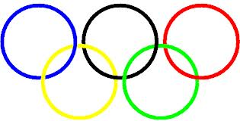
The Olympics
Established by Baron Pierre de Coubertin in 1896
Underlying philosophy of:-
Bringing nations together
Allowing youth to compete across national boundaries
Increasing tolerance
Olympics existed within Victorian ethos
Fair play and sportsmanship- playing with etiquette
Only amateurs could compete
No financial rewards for taking
This meant that taking part was more important than winning.

Slide 3
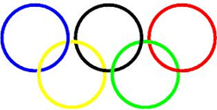
Olympism
Intention was to promote friendship, harmony and understanding.
Symbols designed to reinforce this…
Doves
Symbolise Peace
Rings
Symbolise Harmony
Olympic Oath
“We swear we will take part in the Olympic games in the true spirit of sportsmanship and that we will abide by the rules that govern them, for the glory of sport and the honour of our country”

Slide 4
Modern Olympics
Unfortunately this ethos has shifted in recent years.
Emphasis now on winning
Professional athletes allowed to take part.
Media coverage has increased earning potential of athletes
Nationalistic- countries spending huge amounts of money to develop and train
Elitist
Ben Johnson
Makhloufi
London 2012- Badminton

Slide 5
Contract to compete
Unwritten code whereby performers strive to win against each other.
Formed from Victorian ethos
Athleticism
Amateurism
Sportsmanship
When accepting this contract we expect performers to:-
Try their best
Show sportsmanship
Respect the rules and officials

Slide 6
Morality in sport
Sportsmanship
Character
Fair Play
Sportsmanship
Conforming to the rules, spirit and etiquette of the sport
Fair Play
Allowing all participants an equal chance to achieve victory. Respect for all involved
Character
Values and habits that determine the way a person normally responds to situations.
However, a more negative ethic has invaded sports based on the idea that winning is everything…
Prize Money
Use of Drugs
Gamesmanship
Why do Sportsmen cheat?
Top 10 cheats
Hall of shame

Slide 7
Sportsmanship V Gamesmanship V Cheating
Sportsmanship | Gamesmanship / Cheating
Returning ball to opposition after injury | Arguing with referee
Clapping opposition after losing | Appealing when you know it isn’t yours
‘Walking’ in cricket | Diving
Clapping opposition century | Feigning injury to waste time
Admitting to a foul (Snooker) | Deliberately fouling
Lending opposition a player if short | Drugs
Danny Care
Sportsmanship in football
Penalty sportsmanship
Federer

