Slide 1
1.2- Personality Testing
Can you measure personality accurately?
How do we measure personality?
How does personality affect sporting choice?

Slide 2
Can we measure personality?
Very difficult to measure due to conflicting definitions
Personality tests are frequently used in sport settings and vary in type…
Observations
Interviews
Questionnaires

Slide 3
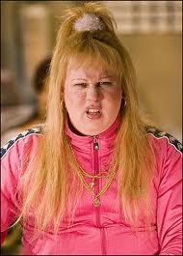
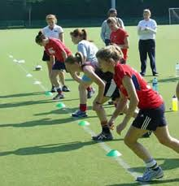
Why measure personality?
The ability to predict who is likely to participate in sporting activities.
Useful for NGB trying to increase people onto participation pyramid
Talent identification programme
Looking to fit personality to type of activity
Obviously this shouldn’t be the only factor to consider as there is much more that affects suitability for sport

Slide 4
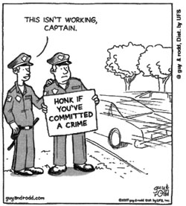
Validity, reliability and ethics
It has been concluded that there is no such thing as a sporting personality
No noticeable difference between people who take part in different sports
Why not?
Validity- does the test measure what it is supposed to?
How can it when we have no clear definition of personality
Reliability- are the results repeatable?
Subjective nature of observations and have to interpret your own personality
Ethics- Testing is designed to probe into sensitive areas, information must be treated with sensitivity and confidentiality

Slide 5
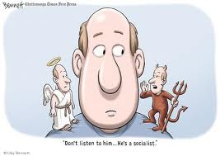
Questionnaires
Most common method used…
Cheap
Easy to produce
Easy to use for larger numbers of subjects
Used almost anywhere
Fairly reliable
However it is difficult to accurately assess your own personality..
Subjective nature of questions
If asked are you often irritable? What counts as being ‘irritable’?
Influence of tester
Answering questions with what you think they want to hear
Self serving bias
Giving answers which protect your own feelings

Slide 6
Interviews
Try to find out personality through discussions…
Questions asked
Asked to interpret drawings
Greater validity than questionnaires- answers aren’t limited to yes/no
However will have limited reliability
Open to interpretation
Self serving bias
One on one is time consuming and expensive

Slide 7
Observations
Responses and behaviour are recorded and analysed
Similarities are noted between participants
Person is more likely to participate as they normally would
However will have low Validity
Difficult to interpret behaviour
Will they behave naturally? (especially if they know)
Expensive
Time Consuming

Slide 8
Profile of Mood States
Some research has illustrated a difference between more and less successful sportsman
Based on mood states and ability to cope rather than personality traits
Measures the following…
Tension, Depression, Anger, Vigour, Fatigue, Confusion
Iceberg Profile
Successful athletes tend to score…
Higher on anger and vigour
Lower on tension, depression, fatigue and confusion
Can also show when overtraining is happening in elite performers- reduced Vigour
Chicken and egg scenario?
Elite become Iceberg or Iceberg become Elite?

Slide 9
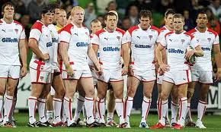
Personality and sporting choice
Is there a relationship between the two?
Disagreement amongst psychologists as whether studying personality has any relevance.
Research has shown…
‘Extroverts’ have lower levels of arousal and can cope more easily with new stimuli
Athletes have common traits:-
More competitive
More outgoing
Higher levels of self confidence
However there has been as much evidence to suggest no link as there has to suggest one.

