Slide 1
1.4 Arousal
What is Arousal?
What are the indicators of Arousals?

Slide 2
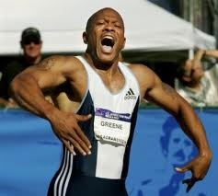
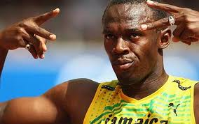
Arousal
Elite performers are frequently seen psyching themselves up
HAKA
Psychological preparation to increase your arousal level is AS important as physiological preparation
“IN THE ZONE”

Slide 3
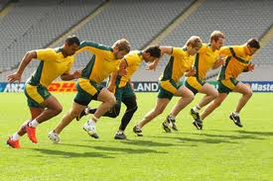
Definitions
Many definitions, some suggesting it is simply a state of heightened psychological activity.
Singer (1993) suggested it involved cognitive processes and physiological responses
Sage (1984) linked arousal to motivation which directs you to a specific goal

Slide 4
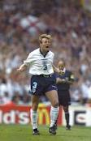
Arousal and performance
As a performer you will have experienced various levels of arousal
and recognise both the physical (Somatic) and mental (Cognitive)
signs.
Could have been experienced before or during an event
Under arousal- feeling flat in your performance and needing motivation
Over arousal- Feeling too excited and needing to be calmed down.
Modern research suggests we have an optimum level of arousal to perform at our best

Slide 5
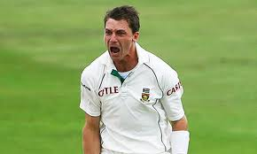
Somatic (Physiological) signs
Increased heart rate
Increased breathing rate
Sweating
Headache
Cold, clammy hands
Dry mouth
Dazed look in eyes
Feeling on nausea
Increased muscle tension
Butterflies in stomach
Constant need to urinate

Slide 6
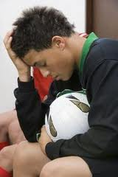
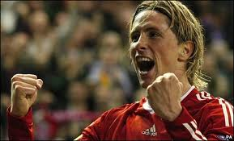
Cognitive (Psychological) signs
Increased focus and concentration
Heightened awareness of cues in environment
Narrowing of attention
Decreased reaction time (To a point)
However if over arousal occurs it can lead to:-
Anxiety and apprehension
Tension
Negative self-talk
Difficulties sleeping
Inability to concentrate
Fear and anger

