Slide 1
1.5- Arousal and Performance
How do we interpret arousal?
What is the Zone of Optimal functioning?
What is Peak flow?

Slide 2
Optimal level of Arousal
It is clear that there is an Optimal level of Arousal
Reaction times are at their fastest
Better able to filter away irrelevant information without suffering from Attentional narrowing
Attentional Narrowing
Occurs when performer is so tightly focused on one aspect they miss other cues from the environment.
e.g. When a defender is focusing so hard on marking their opponent that they miss the flight of the ball
Attentional field
Low arousal
High arousal

Slide 3
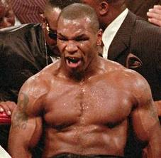
Interpreting Arousal
Your personality will affect how you react to arousal…
Can improve performance if seen as exciting (and vice versa)
Known as Reversal Theory
They see it as their body is getting ready to perform
Therefore if interpret their arousal as low they don’t feel ready
Studies have been conducted as to the relationship between personality and increasing levels of arousal…
Morgan (1980) believes that as Elite performers have lower levels of anxiety that they can cope with higher levels of arousal

Slide 4
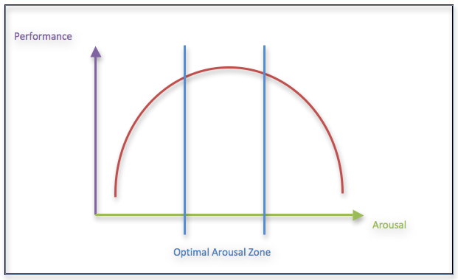
Zone of Optimal functioning
No matter the individual or situation we all seek to be in the Zone of Optimal functioning
The area between upper and lower limits of arousal.
Given the many variables involved referred to
as an individual preference rather than being
able to group performers

Slide 5
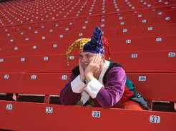
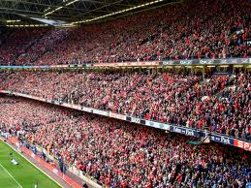
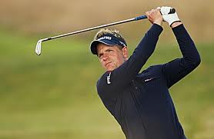
Changing situations
The environment will impact on arousal levels…
Opponents
Actions of team-mates
Officials
Crowd
Evaluation apprehension
When a performer feels their arousal levels elevated during the performance
They may take steps to return to a lower level
Zajonc (1965) proposed that as the presence of others (audience etc.) increases so does arousal.
Dominant response in more likely to occur
Social Facilitation
More experienced performer
Correct response is reinforced- Performance improves
Social Inhibition
Less experienced performer
Incorrect response reinforced- Performance deteriorates

Slide 6
Peak Flow Experience
“Being in the zone”
Period during sport when experiencing a heightened state of consciousness
Perform to the best of their ability…
Exceptional and consistent
Automatic and flowing
Ignore other pressures to let body deliver what it knows well (Murphy, 1996)
Oblivious to other things- all that matters is the performance
Performers who have experienced Peak Flow felt satisfaction and accomplishment.
Research shows it is connected to Alpha brain wave activity.
Perfect Set- Wimbledon

