Slide 1
2.4 Controlling Anxiety
What methods exist to control cognitive anxiety?
What methods exist to control somatic anxiety?

Slide 2
Controlling Stress
Controlling the pressure that sporting performance can bring
Psychological- Optimal state is relaxed concentration.
Need to be alert and attentive without attentional narrowing
Avoid excessive muscle tension
Controlling Stress
Cognitive
Controlling thoughts and attention
Somatic
Controlling physical components of anxiety

Slide 3
Summary of techniques
Cognitive
Somatic
Imagery
Visualisation
Attentional Control (Cue utilisation)
Thought stopping
Self Talk
Bio-Feedback
Breathing Control
Centering
Progressive Muscular relaxation

Slide 4
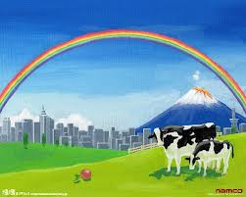
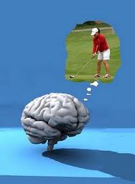
Imagery
Happy Gilmore
Based on concept that best way to reduce stress is to change the environment
Not possible in sport so imagery is used
Using imagination to recreate a specific situation you find relaxing
A scene or place which you remember as safe and peaceful
Trying to bring all your senses to that image
Sounds of running water or birds
Smell of freshly cut grass
Warmth of the sun
Must be your image not someone else’s
Imagery used as rehearsal before a big event
Run through event in your mind to reinforce good habits
Allows you to practice in advance of an event
Preparing yourself for anything unusual which might occur- enabled well learned responses
Allows you to pre-experience your achieving your goals

Slide 5
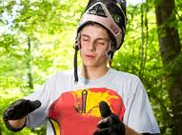
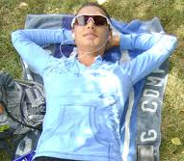
Visualisation
Cool Runnings (5:30)
Locking on to the ‘perfect performance’ to focus on control
Creating a mental image of what you want the happen or feel
Diverts attention away from the causes of anxiety
Dependant on previous learning of perfect movements
Imagining intended outcome of competition
Used to rest and create feeling of calm
Instructed to step back into previous success
Remembering key points
Visual, auditory and kinaesthetic senses
Can be improved similarly to physical practice.
Repeated visualisation can be build on experience and give confidence

Slide 6
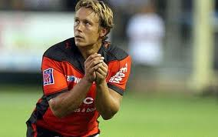
Attentional Control (Cue Utilisation)
Attentional control
Aiming to improve focus on the appropriate cues (Cue Utilisation)
Reducing number of errors through distractions
Appears to involve great strain but reverse is actually true
Being ‘in the zone’ and Peak flow
Concentration is difficult to master…
Orientating response- Bias towards new or novel stimuli
Useful in dangerous situations (Survival instinct)
Means we are prone to distractions
Concentration (Selective attention) can be learned, refined and perfected
Like any physical skill
Need to remain focused on the present,-blocking out past and future concerns
Useful to use keyword such as ‘focus’ or ‘control’
Task orientation rather than outcome
If skill is repeatable add a ritual in
Hestrie Cloete Djokovic Basketball free-throws

Slide 7
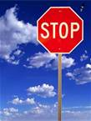
Thought Stopping
Relaxation technique using a simple physical or mental action
Clenching a fist
Imagining a picture or design
Switches your attention to a controlled mental state- reducing cognitive anxiety
When you experience a negative or unwanted thought (Cognitive anxiety)
Think of something distinctive and memorable
Something like a large red stop sign
Every time a negative thought comes into your head, reproduce the image
Hold the image for a few seconds
Then allow it to fade away with the negative thought
Technique can quickly refocus attention
Depending on prior learning to associate response with calm

Slide 8
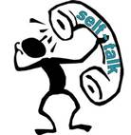
Self Talk
Technique used to take your mind off of the cause of anxiety
Used effectively when fatigued or concentration begins to wander
Vital it remains positive and focuses on self motivational content
Can pre-plan what to say and rehearse
Using positive self-talk to become more aware of thoughts during training and competition
Simple plan to record thoughts- over a few weeks
Allows you to spot any patterns of negative thoughts
Possibility of planning alternative thoughts
Can design positive statements to repeat to yourself
Could be left around to remind you to use them
Need to condition brain over time to notice more positives
Will become a habit over time
From “Am I ready for this?” to “I have trained hard and I am raring to go”
Pride - Power

Slide 9
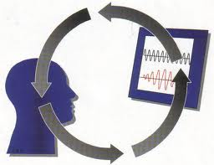
Biofeedback
Monitoring of a physiological variable which is affected by somatic anxiety
Heart rate (Pulsometer/ Heart rate monitor)
Muscle tension (Electromyography EMG)
Sweating (Galvanic skin response GSR)
Blood pressure (Sphygmomanometer)
Breathing rate (Spirometer)
Performer is attached and learns to reduce the physiological variable
Thinking pleasant thoughts
Diverting attention away from anxiety producing stimulus
Reducing state anxiety
Reduction in variable shows reduction in somatic anxiety
Only works if performer has already learned process

Slide 10
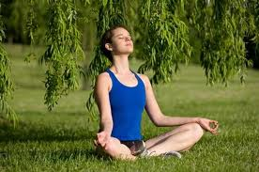
Breathing Control
Focuses on regulating breathing to distract from the anxiety inducing situation
Common feature of several techniques
First step is learning deep breathing…
When done correctly air comes in through your nose and lower belly rises
When first practiced seems unnatural
Linked to body image and keeping a flat stomach
Shallow breathing is more commonly done so seems normal
Encourages full exchange of oxygen
Beneficial trade of incoming oxygen for outgoing carbon dioxide
Can slow the heart rate and stabilise blood pressure
Deep breathing process…
Sit or lie down
Breathe in slowly through your nose
Allow your chest and lower belly to rise.
Let your abdomen expand
Breathe out slowly through your nose (or mouth if feels more natural)

Slide 11
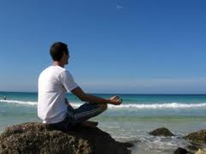
Centering
Centering is used to interrupt a stressful situation to regain concentration.
Requires performer to focus particularly on the rate of breathing
Slow and steady pace
Involves a deep abdominal breath
Concentration on the breath
Then focus switches back to an important external cue
Helps you avoid distractions and release past worry's
Involves repeating a key word or ‘mantra’ to help refocus.
E.G. “relax” or “steady”
Must be practiced often to be available when you need it
Need to develop an automatic relaxation response, changes how you feel.

Slide 12
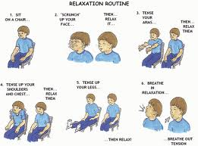
Progressive muscular relaxation (PMR)
Useful relaxation tool when your muscles are tense
Alternates tension and relaxation in muscles of body parts
Coupled with breathing rhythm
Progressively reduces tension
Process…
Tensing up a group of muscles to a state of extreme tension for a few seconds
Relax the muscles normally
Consciously relax muscles even further
Relaxation should be progressive
Starting at the extremities of the body moving towards the centre
Success depends on learning to systematically reduce the tension

