Slide 1
3.1 Attitude
What is an attitude?
What components make up an attitude?

Slide 2
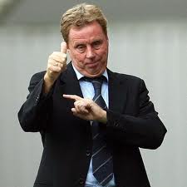
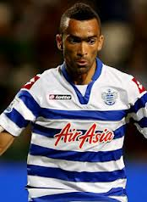
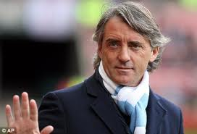
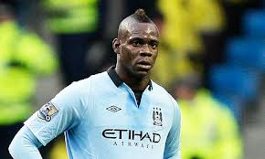
Attitude
A term frequently used, usually commenting on a positive or negative attitude.
Attitude:
“A view held by an individual towards an attitude object”
This existence of an attitude predisposes the person to behave in a certain way towards the attitude object
Attitudes are multi-dimensional
Formed from Knowledge, emotion and behaviour intentions
Harry Redknapp
Roberto Mancini

Slide 3
Attitude in sport
Examples from sport…
Athlete may have a negative attitude towards weight training
Likely to train in a half hearted manner
Leading to plateauing?
Footballer may have a negative attitude towards a particular official
Change their behaviour towards them- disagreeing and arguing
This attitude could stem from a previous encounter
Does this mean that the player will have the same attitude to all officials?
Unlikely as attitudes tend to specific rather than global (Gill, 1986)
Attitude can lead to a prejudice forming

Slide 4
Social Norms
People are often told to change their attitude
If it is not approved of
If it is not helpful
NCPE encourages schools to instil positive attitudes towards sport and PE.
Unfortunately it doesn’t always suggest ways to achieve this.
Social Norms
Unwritten rules about your attitude, values, behaviour or beliefs
Help control behaviour
Based on consensus- Enough people believe them so they are true
Can lead to social acceptance or dissaproval

Slide 5
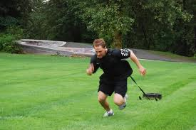
Attitude Components
Triadic Model
Cognitive component- What we know and believe about the object
Affective component- How we feel about the object
Behavioural component- How we respond to, or intend to respond to the object
Example
Hockey player may understand that training will improve their performance (Cognitive)
They enjoy the feeling of improved fitness during the game (Affective)
Plan their session and take part it to their best ability (Behavioural)
Cognitive
Affective
Behavioural

Slide 6
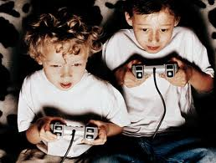
Understanding the components
It is a natural assumption that if our cognitive and associative components are in agreement then it we will behave according to these
However this is not always the case…
Young people may realise that exercise is good for them and enjoy it when they are taking part but may not chose to take part voluntarily.
Fishbein and Azedn (1975) suggested that to predict behaviour a high degree of specificity of both attitude and behaviour components is required

Slide 7
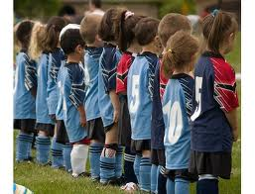
Predicting behaviour
An intention to train for a specific event gives more predictability than just a general intention to train.
A stated intention to behave in a certain way was found to be a strong predictor of actual behaviour
Attitude towards behaviour and generally accepted beliefs (Normative beliefs) both contribute towards predictability of behaviour.
A teenage girl may appreciate the benefits of training and enjoy it but it may conflict with the social norms of her peer group.
To encourage performers to behave in accordance with a set of general values and their own attitudes, you must ensure that…
They understand the specific goals of the session
They have a positive experience at the session
Any negative attitudes or experiences are recognised and dealt with.

Slide 8
Model of predicting behaviour
Beliefs about consequences of behaviour
Attitude towards behaviour
Intention to perform behaviour
BEHAVIOUR
Normative beliefs about behaviour
Subjective norm concerning behaviour

