Slide 1
3.1- Deviance in sport
What is deviance?
Why does deviance occur?

Slide 2
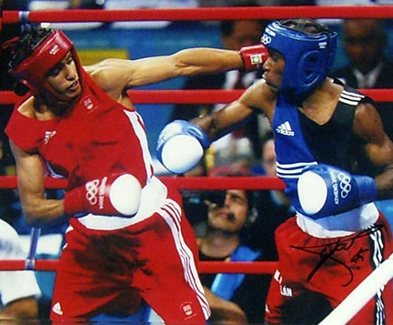
Deviance
Any behaviour which differs from the perceived social or legal norm.
It is possible to find examples of behaviour within sport which are considered acceptable but would be unacceptable in wider society.

Slide 3
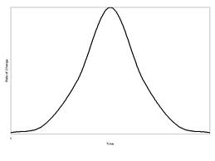
Types of Deviance
Usually given a negative connotation
However you can have examples of positive deviant behaviour
Jay Coakley (1992) suggested 3 types of behaviour
Positive deviance Normal behaviour Negative deviance

Slide 4
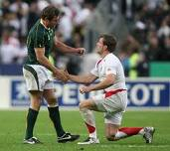
Positive Deviance
It is possible to move away form the norm without an intention to do harm or break the rules.
Someone who trains or plays so hard they injure themselves.
Someone who plays when injured (often praised by media)
Because their actions are within the rules of the game and are simply in an attempt to win, their deviance form the norm is seen in a positive light.
You could also argue that someone who accidentally injures another player within the rules of the game is displaying a positive deviance.

Slide 5
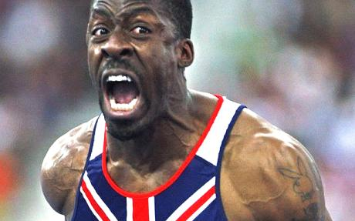
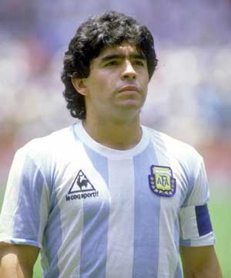
Negative Deviance
Occurs when a player, manager, spectator or anyone involved behaves in a way that knowingly breaks the rules or ethics of the sport.
Using performance-enhancing drugs
Cheating within a contest
Being bribed to influence he results
Fan violence and hooliganism
Illegal betting on the outcome
Financial irregularities
Player violence
Fielding ineligible players

Slide 6
Examples of Deviance in sport
Thierry Henry
Manusamoa Tuilagi
Cristiano Ronaldo
Neil Back
Tom Williams
Nani
Michael Schumacher
Ben Johnson
Mike Tyson
Olexandr Aliyev
Sportsmanship in football
Poalo Di Canio
Luis Suarez

Slide 7
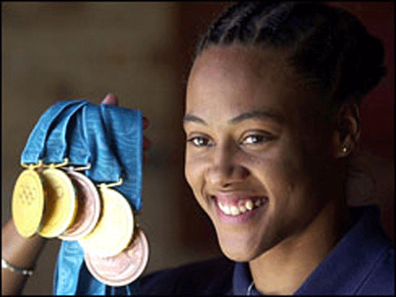
Relative Deviance
Actions which are considered acceptable in sport but wouldn’t be in society
Seen in rugby when raking an opponent who is on top of the ball.
You get some examples where the issue goes beyond governing body of sport and goes to the police
Marion Jones- 6 months in jail
Ben Thatcher- Charged with ABH

Slide 8
Contract to compete
Agreement between everyone involved with sport
You strive to do your best- Otherwise you deprive opponents of achievement and spectators of getting what they paid for
You do not break the rules in a desire to win
You are expected to allow opponents a fair opportunity to win- taking of drugs or bribing an official
However...
Within the characteristics of the activity you can use all tactics, techniques etc to prevent your opponent form beating you. (relative deviance)

Slide 9
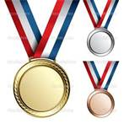
Causes of Deviance
Why does deviance occur...
Individuals lacks the moral restraint to resist
Individuals value wining ahead of prospect of punishment
Rewards for winning are so great that people are prepared to risk it.
Deviant behaviour is more common so less socially unacceptable
Governing bodies feel less able to punish, owing to commercial interests or fear of being taken to court.

