Slide 1
3.3 Learning Theories- Conditioning
What is operant conditioning?
How is reinforcement used relating to the Stimulus response bond?

Slide 2
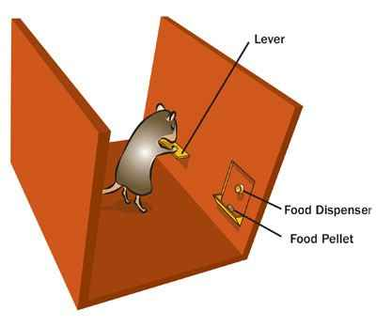
Operant Conditioning
Skinner found that rats learned to hit a lever which presented them with food.
He called this process of learning to repeat actions for reward operant conditioning.
Operant conditioning suggests that a correct response to a stimuli can be encouraged by:-
Positive reinforcement to encourage correct response
Negative reinforcement to discourage incorrect response
This relationship between stimulus and response is known as the Stimulus-Response bond
When a correct action is reinforced the link to the correct response becomes stronger
When an incorrect action is not reinforced the link to the correct response becomes weaker

Slide 3
Operant Conditioning (cont.)
Strengthening the SR bond
Positive reinforcement- praise or rewards
Early success- Coach should set easy targets to ensure initial success (develops confidence)
Mental rehearsal- Going over performance helps develop an automatic response
Task as a whole- Coach should allow performer to practice skill as a whole to develop understanding
Negative reinforcement- withdrawal of praise which had previously been given
Punishment- Use carefully to avoid lowering confidence/motivation (fine, dropped from team or made to do extra training)
Thorndike’s three laws to promote learning
Law of exercise- practice will strengthen the SR bond
Law of effect- praise will strengthen but criticism will weaken
Law of readiness- tasks need to be within capabilities of performer

Slide 4
Criticisms of Operant conditioning
Learner isn’t required to understand why they should do something.
Can lead to a lack of motivation
Trail and error may lead to the wrong technique being adapted if it meets initial success.
May then need to un-learn the skill
Learner may not know how to react when the stimulus is slightly different from those already experienced.
Links to Schema theory
Form of learning implies that every situation has a stimulus-response bond created
Is this realistic?
Beginners do not react well to negative reinforcement and the use of punishment.
Requires the learner to react without understanding

