Slide 1
3.4- Drugs in Sport
Why do performers take drugs?
Who is involved in the battle against drugs?
What is done to deter the use of drugs in sport?
Are drugs a legal or moral issue?

Slide 2
What drugs are we talking about?
Specifically looking at Performance enhancing drugs (PEDs)
You have previously looked at the effects of these drugs, now concerned with the following…
Ethics of drug use
Methods of testing
Policies to deter their use
We are concerned with drugs which act as an ergogenic aid- improve performance beyond what could be achieved normally
Erythropoietin (EPO)
Human growth hormone (HGH)
Diuretics
Anabolic Steroids
Beta blockers
Stimulants

Slide 3
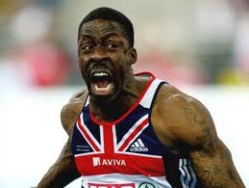
Why do performers use drugs?
Similar to reasons given for any deviant behaviour…
Some performers may lack the moral and ethical boundaries that prevents others
Belief of everybody else is doing it
Lack of physical attributes to get to the top without it
May not be fully aware that they are using drugs
Giving control over to their coach
Not aware what substances are in medication
Potential rewards are so great
Receive wrong guidance from educational programmes
Not fully aware of health risks of PEDs
Tempted to speed up a recovery process
The use of PEDs is more common in sports with more closed skills than open skills, Why?
Greater emphasis on physiological than any decision making
Steffon Armitage
Alan Baxter
Lance Armstrong

Slide 4
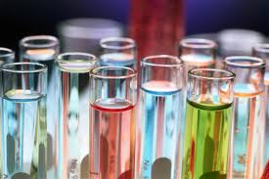
The battle against drugs
Every governing body of sport is engaged in trying to find, punish and ultimately prevent the use of drugs
They do this in a number of ways…
Providing testing regimes and laboratory facilities to test
Taking action against those who have been proved to used banned substances
Educate young performers in the ethics surrounding the use of drugs in sport
Educating young performers as to the potential health risks
Ensuring performers know what substances are allowed and what they are responsible for

Slide 5
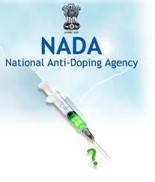
Who does what?
World Anti Doping Agency (WADA)
First and foremost international body
Responsible for promoting, organising and co-ordinating the fight against the use of drugs in sport.
Introduced World Anti-doping Code
Promotes research into detection of drugs
Assists national governing bodies
Assists poorer nations with testing
UK Sport had primary responsibility for anti-doping policy
Drugs control centre established to analyse samples
UK Sport has now handed over responsibility to a new agency, called the National Anti Doping Organisation (NADO)
NADO coordinate by…
Determine which sports are required to provide information
Liaise with NBG to decide who will be tested…
Performers then required to provide quarterly information on whereabouts and details of training and competition schedule
Missed test or failure to attend count as a strike- 3 strikes in 18 month period means a violation
Leading to a sanction of a 1 to 2 year suspension

Slide 6
How do we deter performers from taking PEDs?
NGBs are educating performers
Ensuring all performers are aware of testing regimes
Increase in the number of out-of-competition testing (No warning)
Increasing the severity of punishments
Efforts made to increase consistency across different countries
Use of positive role models to help educate
Development of more sophisticated testing- on-going battle
More use of the law, performers are open to prosecution and possibility of a prison sentence

Slide 7
Should PEDs be banned?
Yes
No
Permanently damaging side effects of PEDs are known and inevitable
If PEDs are legalised the conception will be that you can’t succeed without them, pressures all performers to take them to stand a chance.
Performers may come under increased pressure from a variety of sources to take them.
Will create an un-even playing field where those with more money will have an unfair advantage due to access to PEDs
KEY ARGUMENT?
Sport is about the development of natural talents. Using a PED goes against this as it is not the same as a training aid. It doesn’t enhance existing abilities but artificially boosts performance by giving them something that wasn’t already there.
Unethical and goes against the very nature of sport
Testing process is time consuming and expensive
Detection is not always consistent across sports
Testers are behind in terms of masking agents, gives a window of time where they may be undetected
Ambiguity between what is a nutritional supplement and what is drug
Long term effects of training can be dangerous anyway- sacrifices made are a personal decision, so why is taking PEDs any different?
Taking PEDs will increase standards, making sport more exciting and increasing number of people who make a living from sport
If using PEDs become a choice then it creates a level playing field
Level Playing field doesn’t exist anyway as more money means better sports science support available- PEDs no different to this.

