Slide 1
3.5 Disability and social class
What disability based barriers to participation do people face?

Slide 2
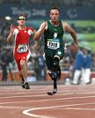
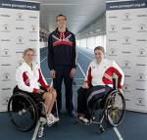
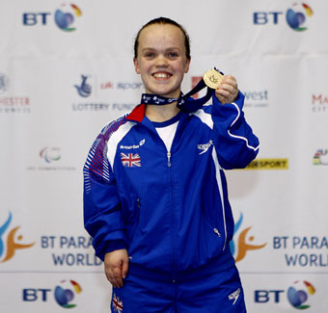
Disability
People with disabilities have a low level of participation in sport.
Society continues to discriminate against, and impose barriers on, disabled people’s participation in physical activity
Barriers
Myths and stereotypes
Negative self image and lack of confidence
Low income levels- ¾ rely on benefits
Lack of transport
Lack of specialist coaches
Lack of specialist equipment
Fewer competitive opportunities
Low levels of media coverage and role models
Solutions
Educate people about myths (challenge attitude)
Provide opportunities for success
Increased investment in disabled sport
Provide transport to facilities
Increased number of competitions at all levels
Increased media coverage
Eleanor Simmonds-
100m S6 World record holder

