Slide 1
4.1- Confidence and Efficacy
What is confidence and efficacy?
How can they be increased?
What affect does an audience have on performance?

Slide 2
Confidence
Jonny
Confidence is defined as....
“Having a strong belief in one’s own ability to achieve success”
Key aspect at elite level sport- Confident athletes expect to do well
Can often be the only difference between people who are evenly matched
Many people assume it simply reflects performance
E.g. Confident once we have started performing well
However it is becoming more evident that it can be established before
Lack of confidence can lead to doubt and under-performance
Fernando Torres at Chelsea

Slide 3
Self efficacy
Self Efficacy
Performance accomplishments
Vicarious experiences
Verbal Persuasion
Emotional arousal
Bandura defined Self Efficacy as situational specific confidence which is based on 4 primary sources of information
Performance accomplishments
What you have achieved in training and competition forms basis of future expectations.
Success leads to positive expectations and enhanced self belief- Coaching implications
Vicarious experience
Seeing someone else achieve success can help motivate you and give belief.
Needs to be someone of a similar ability to be effective.
Verbal Persuasion
Use of careful reasoning to show others have faith in performer’s ability
Could also be done in the form of self talk
Emotional arousal
Interpretation of somatic signs of anxiety- Increased Heart Rate means you are ready.

Slide 4
Increasing Self Efficacy
Ensure individual achieves success
Manipulate training environment (Successful and positive reinforcement)
Playing very winnable games(More difficult at elite level)
Effective Goal Setting
SMARTER- Especially realistic so that success is possible
Goals should emphasise individual targets rather than team
Encouraging cognitive methods of controlling anxiety (already covered)
Self talk
Imagery and Visualisation
Ensure any routines/superstitions can be maintained
Increase motivation using extrinsic rewards
Important not to be overused

Slide 5
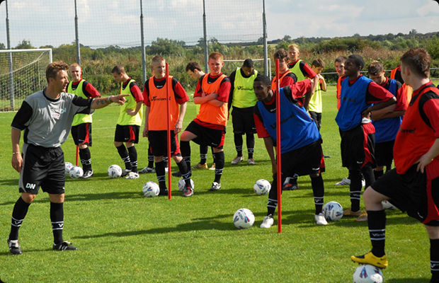
The effect of an audience
Theory of Social facilitation (Zajonc)
The behavioural affects due to the presence of others.
Split into 2 forces- Audience and Co-action (Teammates or opponents)
Found that the presence of others...
Helped well learnt or simple skills (Facilitation)
Hindered new or complex skills (Inhibition)
Links back to Drive Theory as increased arousal (from presence of others) increases the likelihood of dominant response being given.
It is clear now that not all ‘others’ will have the same effect...
Evaluation Apprehension
When we think we are being assessed or judged the effects will be stronger

Slide 6
The effect of an audience (Cont..)
Distraction-Conflict theory (Baron)
Presences of audience linked to information processing
Suggests audience takes up much of our Attentional capacity
Presence creates higher levels of arousal
Might not be able to cope with a more complex or newly learnt task
Demands of task
CONFLICT
Increased Arousal
Social Facilitation
Athlete performing
Distraction of audience

Slide 7
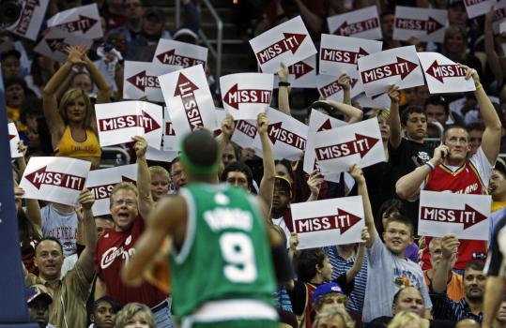
Limiting the effects of an audience
Learn new skills in the absence of an audience
Dominant response
Gradually introduce an audience once skill can be accomplished
Initially in training before competition
Encouraging cognitive methods of controlling anxiety (already covered)
Self talk
Imagery and Visualisation
Increased Self Efficacy
Performance accomplishments
Vicarious experiences
Verbal Persuasion
Emotional arousal

Slide 8
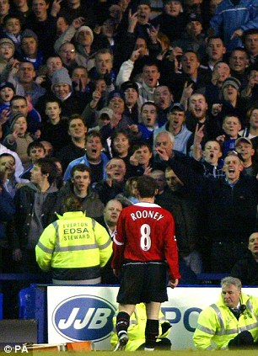
Home-Field Advantage
Common feeling in sport that a team playing at home has an advantage- But do they?
It is generally seen that more support will result in a better performance...
Audience can create “Functional Assertive behaviour”
Home team playing more ‘aggressively’
More effect the higher the standard of the sport
Increased Arousal = Increased Drive = Dominant response = Social Facilitation
Increased anxiety for away team
However the pressure of an expectant crowd can have negative effects on performance
More self conscious leading to over arousal
Catastrophe theory
Evaluation Apprehension due to expectant crowd
Potential Social Inhibition if not at elite level or complex skills
Kay factors in determining the effect of a crowd...
Size of crowd
Proximity of crowd- How close to the pitch?
Importance of game and how hostile crowd are (Choke effect)

