Slide 1
4.2 Sponsorship
What are the advantages and disadvantages of sponsorship?
What are the ethical implications of sponsorships?

Slide 2
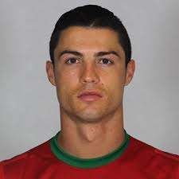
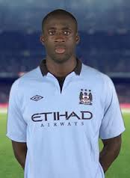
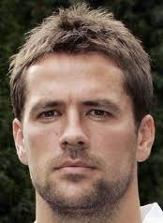
Name their sponsor?
Nike
Grays
Puma
Adidas and Head
Umbro
Woodworm

Slide 3
Name the club?
Aston Villa
Liverpool
Stoke
Spurs
Wigan
Palace

Slide 4
Sponsorship
Companies invest in sport for many reasons…
Sponsor’s name and product is given publicity
An association with a successful performer reflects favourably
Sponsor is seen as supporting the community or country
Sponsorship reduces the amount of tax paid by a company
All leading to an increase in sales and potentially new products being able to be introduced

Slide 5
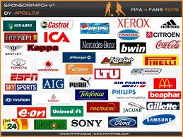
What affects a companies decision to become a sponsor?
Success of the team or individual
Popularity of the sport
Media coverage given to the sport
Participation levels in the sport
Suitability of the sport for the product

Slide 6
Advantages of sponsorship
Sport is expensive to run
Extra money allows a more professional approach
Sport is promoted through extra publicity
Sponsorship helps to create atmosphere at events
Sports will be more organised
Better management techniques and business advice
Improved facilities
Benefit both the performer and spectator
England Hockey

Slide 7
Disadvantages of sponsorship
Sport becomes associated with a product, this may be undesirable
Sponsors can gain control over organisation of sport
Sponsors can gain control over timing and location of events
Financial interdependence between media and large sporting events
Sport relies on funding
Withdrawal of funding would be disastrous
How many sponsors of the Football league cup can you name?
1982–1986
Milk Cup
1986–1990
Littlewoods Challenge Cup
1990–1992
Rumbelows Cup
1992–1998
Coca-Cola Cup
1998–2003
Worthington Cup
2003–2012
Carling Cup
2012–2016
Capital One Cup

Slide 8
Ethical Implications of sponsorship
Positive
Negative
Promotes individual teams
Allows performer to train longer
Development of new competitions
Development of better facilities and equipment
Attracts highest class performers
Generates media interest
Covers expenses of sport
Attention on high profile individuals or teams only
Product association is an intrusion into sport
Sponsors can gain too much control over sport
Sponsors may influence choice of performers
Sponsors can give a bad image
Sponsors will control timings to ensure peak audiences

Slide 9
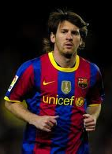
Institue of Sports sponsorship (ISS)
Established in 1985
Non profit making group who link with Sport England
Aims to…
Bring sports and sponsors together
Ensure companies receive fair return for their investment
Try to preserve traditional nature of sport
Run the Sportsmatch scheme with the government

