Slide 1
4.3 Technology
What are the technological developments in elite sport?
Has this improved elite level sport?

Slide 2
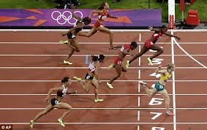
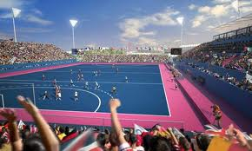
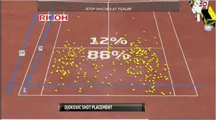
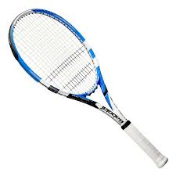
Technological developments
Technology in sport
Society has seen a huge increase in technology…
Sport reflects society so it too has seen changes
Television match officials
Instant replays
Accurate timing devices
Analysis software
Equipment developments
Increase quality of sport
Links back to media
Artificial surfaces

Slide 3
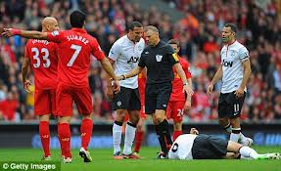
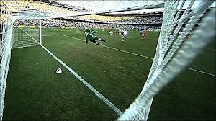
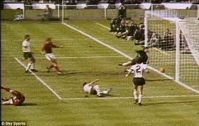
Advantages of using technology?
Ensure correct decisions are made
Fair competition
Players more confident in decisions
Less controversy?
Helps officials communicate with each other
Less pressure on official to make the final judgement
Less post-match criticism
Accurate Timing and measurements
Creates excitement in crowd waiting for decision
Allows players to officially challenge decisions
Ensures competition is more likely to happen
Artificial surfaces
Goal Line technology

Slide 4
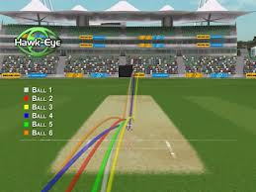
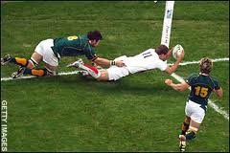
Disadvantages of using technology?
Changes the nature of the sport
Cost limits use of technology at events
Not consistent for all players or spectators
Lower level sport
Breaks in play can be disruptive for spectators if too long
Links back to media interest
Officials using technology can still be wrong
Technology can’t be used for everything- Reliance
Loss of respect of official’s decision being final
Specific technology used must be accurate
High level of reliability

