Slide 1
4.3- Cohesion
What is cohesion?
What different types of cohesion are there?

Slide 2
Starter
Feedback from you extended learning Sociogram
What does this tell you about the dynamics of the group?
How could a coach use this information?

Slide 3
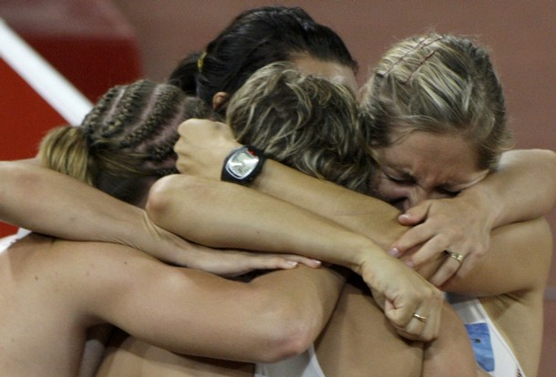
Cohesion
As a team moves through Tuckman’s model they develop cohesion.
Teams that are successful are described as being very cohesive
But what does that mean?
Carron et al define cohesion as:-
“A dynamic process which is reflected in the tendency of a group to remain united in the pursuit of its goals and objectives, and/or for the satisfaction of it’s members’ needs”

Slide 4
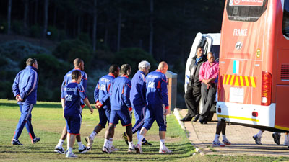
Types of Cohesion
It has been suggested that individuals choose to stay together as a group because either:-
They find the group attractive and value being a member of it
The group helps them achieve an objective
This has been further researched and two types of cohesion have emerged:-
Task Cohesion
How well the group works together to complete an objective?
Social Cohesion
How much the team like each other and interact?
For a team to be truly cohesive they need both types of cohesion , however a team with high levels of task cohesion can put to one side a lack of social cohesion and still work towards meeting their goals.
France World Cup 2010

Slide 5
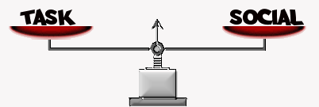
Types of Cohesion (cont.)
Carron suggested that cohesiveness is founded on four elements:-
Individual attraction to the group- TASK
How much a member is involved with the group’s task
Individual attraction to the group- SOCIAL
How a team member feels about their personal interactions within the group
Group Integration- TASK
How much a team member feels the group is focused and unified in its pursuit of an objective
Group Integration- SOCIAL
How a team member feels their group is unified socially

Slide 6
Carron’s Antecedents
An antecedent is something which come before, therefore these are the factors needed for the development of cohesion
Environmental
Contractual obligations
Organisational factors- group size, age, location etc
Personal
Similarity/dissimilarity to group
Satisfaction and aspirations
Team
Focus on task, desire for success and shared experiences
Team ability and stability
Leadership
Leadership style used
Relationship between members and leader

Slide 7
Developing Cohesion
There are many ways to try and develop cohesion:-
Maintain communication with trust and respect
Set SMARTER individual, unit and team goals agreed by all
Agree norms of behaviour
Ensure clarity of role within group (and acceptance by others)
Value contributions of all team members
Reward exceptional contribution (Man of the match etc)
Use team meeting to resolve any conflicts
Create a sense of distinctiveness (Uniform, routines, rituals etc)
Encourage self sacrifice- more skilled help less skilled
Remember the titans
Haka Battle

Slide 8
Questionnaire
Complete your copy of the Group Environment Questionnaire for how you feel about the team you play for:
Score each statement between 1 and 9 ( 9 = strongly agree and 1 = strongly disagree)
I enjoy being part of the social activities of this team.
I’m happy about the amount of playing time I get.
I am going to miss the members of this team when the season ends.
I’m happy with my team’s level of desire to win.
Some of my best friends are on this team.
This team gives me enough opportunities to improve my personal performance.
I enjoy other parties less than team parties.
I like the style of play on this team.
This team is one of my most important social groups.

Slide 9
Questionnaire (cont.)
Our team in united in trying to reach its performance goals.
Members of our team would rather go out together than on their own.
We all take responsibility for any loss or poor performance by our team.
Our team members often party together.
Our team members don’t have conflicting aspirations for the team’s performance.
Our team would like to spend time together in the off-season.
If members of our team have problems in practice, everyone wants to help them so we can get back together again.
Members of our team stick together outside of practices and games.
Our team members communicate freely about each athlete’s responsibilities during competition or practice.

Slide 10
Questionnaire (cont.)
Now add your scores together for each of the questions as grouped below
Attraction to group – task – 2,4,6,8 (range 4-36)
Attraction to group – social – 1,3,5,7,9 (range 5-45)
Group integration – task – 10,12,14,16,18 (range 5-45)
Group integration – social 11,13,15,17 (range 4-36)
The higher the score the greater you reflect that dimension within your team

