Slide 1
4.4 Theories of Cohesion
What is Steiner’s model of productivity?
What is the ‘Ringlemann effect’ and ‘Social loafing’?
How can a team reach it’s potential?

Slide 2
Starter
Feedback from Group Environment Questionnaire
Stronger task or social cohesion?
What impact does this have on performance?
Any low scores?
What affect could this have?

Slide 3
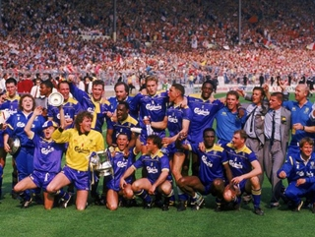
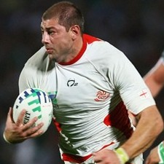
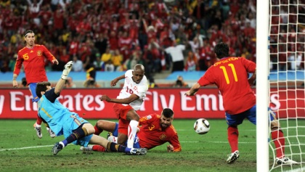
A champion team will defeat a team of champions.
Do you agree?

Slide 4
Steiner’s Model
Steiner (1972) produced a theoretical model of productivity
Actual Productivity
Potential Productivity
Losses due to faulty group processes

Slide 5
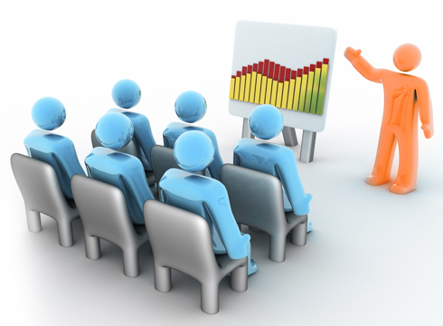
Steiner’s Model explained
Actual productivity
The team performance at any given time (due to successful interaction)
Potential Productivity
The maximum capability of the group when cohesiveness is strongest
Losses due to faulty group processes
Factors that go wrong in team performance which impede/ prevent group cohesion

Slide 6
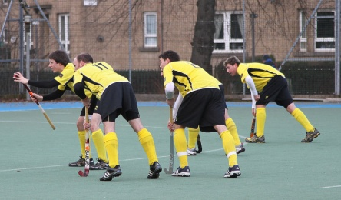
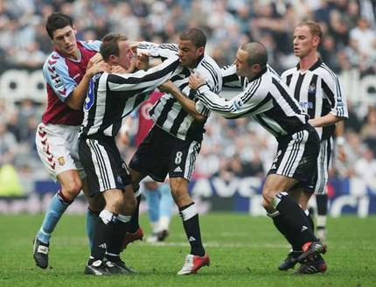
Faulty group processes
There are 2 types of losses due to faulty group processes:-
Co-ordination losses
Operational effectiveness of group cannot be maintained during the match
Strategies or tactics go wrong due to positional error or bad timing (lineout's, penalty corners, free kicks)
Motivation losses
Reduction of effort causing someone to coast
Might think task is too difficult or have had a bad experience
Duplication of roles

Slide 7
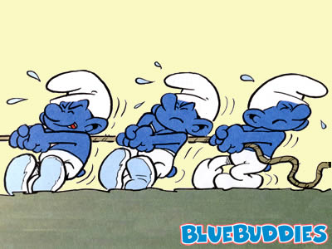
The Ringlemann effect
Observed tug of war and found that the more people on the rope the less hard each individual pulled.
Originally was thought to be a co-ordination loss as it became more difficult to co-ordinate effort as size increased. Now known as a motivational loss.
As a group grows larger the contribution
of an individual diminishes.

Slide 8
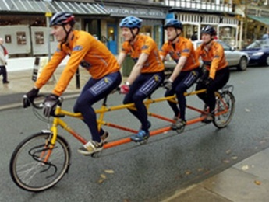
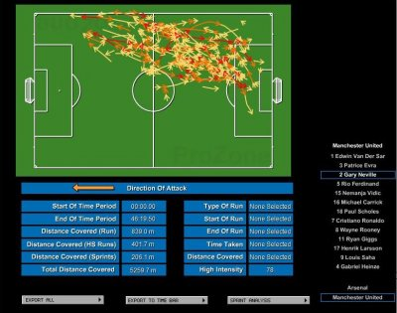
Social Loafing
May feel personal contributions have little effect on group
May see others reducing their effort
Reduced likelihood when people feel their efforts are being monitored.
(Modern technology)
As a group grows larger the contribution
of an individual diminishes.

Slide 9
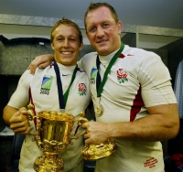
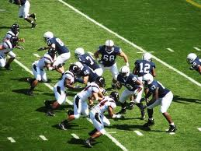
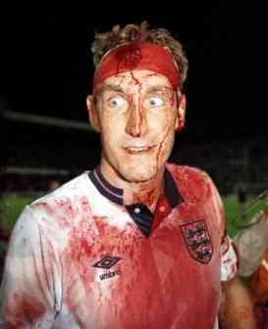
Reaching a team’s potential
For a team to reach it’s potential they need to reduce the co-ordination and motivation losses.
Co-ordination losses
Engage in drills that develop interactive play
Ensure all member’s have role clarity
Practice set plays
Motivation losses
Ensure everyone’s contribution is noted
Develop intrinsic and extrinsic motivation (praise and man of match etc)
Ask all members to value contributing of others- particularly those in less glamorous roles
Develop task cohesion by ensuring objective is clearly understood
Ensure leadership role (captain) is effective in stopping any losses during game

