Slide 1
Application of Forces
Learning Objectives:
To understand the concept of ‘impulse’ in relation to sprinting.
To understand the principles behind rotating motion.
To be able to explain how a shot putter maximises distance thrown.

Slide 2
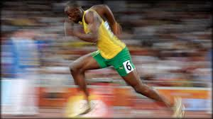
Impulse
The effect of a force acting over a period of time.
Impulse = force x time
Impulse is the same as change in momentum.
Remember: momentum = mass x velocity
Therefore: force x time = mass x velocity

Slide 3
Force-Time Graphs
Positive Impulse – an impulse that moves the body.
Negative Impulse – a force generated when absorbing body motion (landing).
A force-time graph shows forces over time (impulse)

Slide 4
Acceleration - The negative impulse (below the line) is smaller than the positive impulse (above the line). - The sprinter has positive momentum and is therefore accelerating.

Slide 5
Constant Velocity - The positive impulse from the push is the same as the negative impulse from footfall. - Net impulse is zero. - No change in momentum and velocity remains constant.

Slide 6
Deceleration - Towards the end of the race. - Negative impulse from footfall is greater than the positive impulse of the push phase. - The result is negative net impulse = deceleration.

Slide 7
The Body in Rotation
Some Key Terms:
Angular Velocity
Angular Acceleration
Angular Momentum
Moment of Inertia
Conservation of angular momentum
The rate of movement in rotation
The rate of change of velocity during angular movement
The amount of motion that the body has during rotation (angular velocity x moment of inertia
The resistance of a body to change of state when rotating
The principle that the angular momentum of an object remains constant as long as no external force (moment of torque) acts on that object

Slide 8
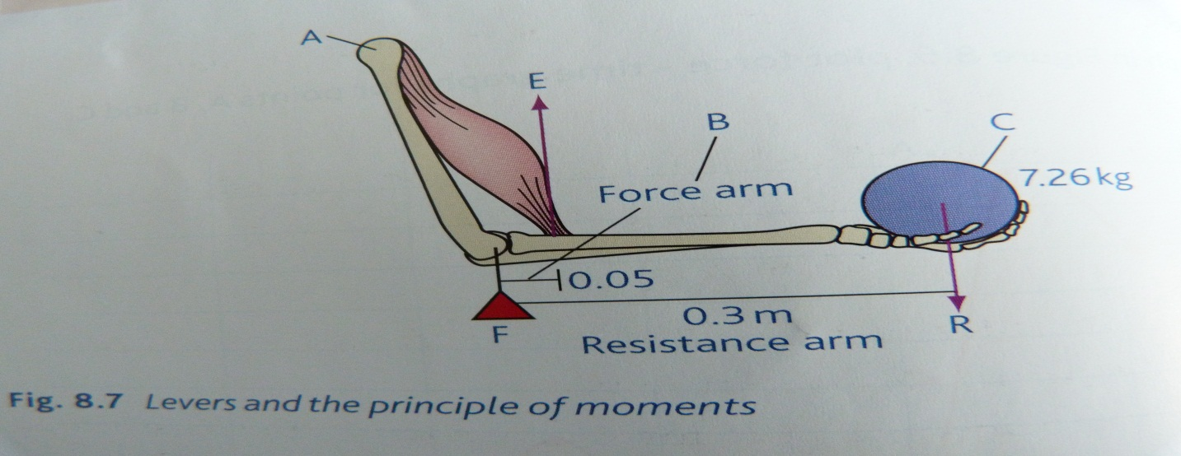
Levers and Principles of Moments
The amount of turning force that is generated by a resistance is known as the torque or moment of force.
Torque = resistance x distance from axis
This is known as the moment arm and is either a resistance arm or an effort arm.

Slide 9
Because the weight of the shot is causing a resistance to motion, it is the resistance arm.
Moment of resistance = load force x distance of load
(or resistance arm) from fulcrum
Moment of resistance = 7.26kg x 0.3m
Moment of resistance = 2.18Nm
To hold the shot still the moment (turning force) of the effort arm’s anticlockwise movement must equal the moment (turning force) of the resistance arm’s clockwise movement.

Slide 10
Moment (effort arm) = effort force x distance from the fulcrum
Moment (effort arm) = effort x 0.05m
To hold the lever still:
Anticlockwise moment = clockwise moment
(effort) (resistance)
0.05m x effort = 2.18Nm
Effort = 2.18/0.05 = 43.6kg
This is known as the principle of moments.

Slide 11
To make the lever rotate upwards, the force generated by the muscle must overcome the moment of inertia.
Moment of inertia = mass x distance from fulcrum
The further the mass from the point of rotation, the greater its moment of inertia.
Think of an ice-skater or trampolinist trying to perform a spin – they spin faster when in the tuck position as the distance from the fulcrum is lower and so the moment of inertia is smaller.

Slide 12
Angular Movement
Angular momentum is the amount of motion a body has when rotating.
Angular momentum = angular velocity x moment of inertia
(remember moment of inertia = mass x distance from axis)
Angular moment follows Newton’s first law (which in this case is known as the ‘conservation of angular momentum.’
A body will continue spinning unless a force (e.g. air resistance, friction) acts on it.

Slide 13
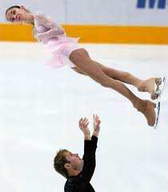
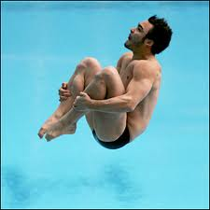
Moment of inertia = mass x distance from axis
A body cannot change its mass during a movement but can its distance from axis of rotation.
If mass moves closer to the axis (tuck) then moment of inertia decreases.
If moment of inertia decreases then angular velocity must increase.
Youtube example

Slide 14
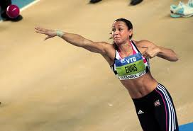
Flight Paths of Objects in Sport
Understanding flight path can help determine optimal angle of release and thus help a performer maximise distance thrown.
The flight path of a shot follows a parabolic curve (as it is relatively unaffected by air resistance)
The flight of the shot has both horizontal and vertical components.

Slide 15
Gravity will act on the shot converting the positive vertical component into a negative vertical component.
It is in the shot-putters interest to release the shot at the highest point above the ground.
Distance thrown is greatly affected by angle of release and speed of release (release velocity).
As angle of release increases, velocity decreases.
Therefore, an angle of about 34 degress is thought to be optimal.

