Slide 1
AS PE PHYSIOLOGY EXAM QUESTIONS & MARK SCHEMES

Slide 2
LUNG FUNCTION
State 2 ways in which carbon dioxide is transported in the blood. (2 marks)
Dissolved in blood plasma (5 %)
Combined with haemoglobin in red blood cells (20%)
Combines with water to form bicarbonate ion / hydrogen carbonate(70%)

Slide 3
For effective performance, games players require oxygen to be delivered to the muscles and carbon dioxide to be removed. Explain how oxygen is taken up by haemoglobin from the lungs and released at the muscle site. (4 marks)
Air in lungs has high PO2 (partial pressure of oxygen) / concentration of oxygen.
Low PO2 in deoxygenated blood returning to lungs.
Concentration / diffusion gradient means oxygen passes from alveoli into blood stream.
Same occurs at muscle site where there is a high PO2 in bloodstream and low PO2 in muscle cells.
Partially permeable membrane.
Carbon dioxide transported by the same process but in the opposite direction at each site (e.g. low PCO2 in oxygenated blood and high PCO2 in muscle cells).

Slide 4
Explain why aerobic training improves the performer’s ability to transport oxygen. (2 marks)
The alveoli provide the lungs with a large surface area for diffusion. Name two other structural features of the lungs that assist diffusion. (2 marks)
a)
Cardiac hypertrophy leads to greater stroke volume / cardiac output
Greater capillary networks
Increased blood volume and haemoglobin levels
b)
Permeability of alveoli (partially permeable membrane)
Short distance from alveoli to capillary
Slow movement of blood through capillaries
Moisture layer enhancing the uptake of oxygen

Slide 5
Use the information in Figure 1 to explain how oxygen and carbon dioxide move between the two locations. (3 marks)
Figure 1:
Alveolus
pO2 = 40 mm Hg
pCO2 = 46 mm Hg
Blood capillary
High PO2 in alveolus, low in blood capillary (opposite for CO2)
Movement from area of high concentration to low concentration
Concentration / diffusion gradient

Slide 6
How is breathing rate regulated by the body to meet the increasing demands of exercise during a game of netball? (3 marks)
Describe the process of breathing from the point just before the start of inspiration until the end of expiration (5 marks)
a)
Controlled by respiratory centre in medulla oblongata
Increase in CO2 levels / lactic acid / lower pH detected by chemoreceptors
Activity from brain in anticipation of exercise
Proprioceptors in muscles and joints detect movement
Increases in body temperature
b)
Inspiration caused by lowering air pressure in lungs by increasing volume of lungs.
Achieved by diaphragm contracting and flattening and intercostal muscles lifting ribs up and out.
Air moves from area of higher pressure (atmosphere) to area of lower pressure (lungs).
Opposite occurs for expiration
Inspiration active process / expiration passive process (when at rest)

Slide 7
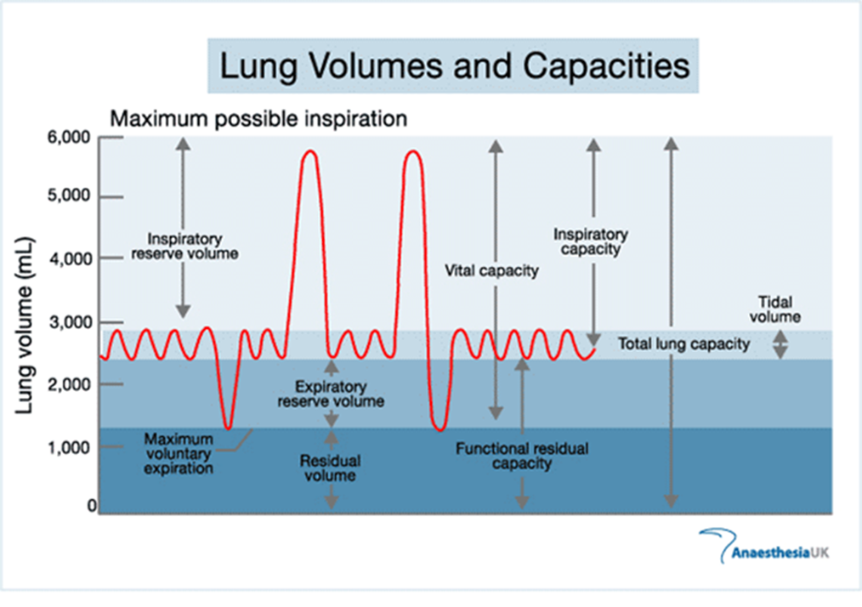
Figure 2 is a graph showing the typical readings of a spirometer.
Figure 2:
Which lung volumes are represented by D and E? (2 marks)
How would you expect volumes A, B and C to be affected during a game of rugby? (3 marks)
A
D
C
B
E

Slide 8
a)
D – vital capacity
E – residual volume
b)
A – inspiratory reserve volume decreases
B – expiratory reserve volume decreases
C – tidal volume increases

Slide 9
During a game of tennis, a player’s breathing rate may vary.
Explain how increases in levels of carbon dioxide and acidity in the blood cause breathing rate to rise. (3 marks)
Breathing rate increases to get more oxygen into the blood. Gaseous exchange involves oxygen diffusing across membranes. Identify the membranes involved in this diffusion and identify one characteristic of these membranes that allows diffusion to happen.(2 marks)
a)
Detected by chemoreceptors
Message sent to respiratory centre in medulla oblongata
Activation of sympathetic nerve
Causes increased rate of contraction of diaphragm and intercostal muscles
b)
Alveolar / muscle cell / capillary wall membranes
Thin membranes / one cell thick / partially permeable
Short distance between membranes
Moist surface

Slide 10
a) Explain how oxygen is taken up by haemoglobin from the lungs and released at the muscle site. (3 marks)
b) Explain why aerobic training improves the performer’s ability to transport oxygen. (2 marks)
a)
Process of diffusion / high to low concentration
High PO2 in lungs, low in deoxygenated blood returning to lungs
High PO2 in oxygenated blood, low in muscle cells
b)
Increased red blood cell levels / haemoglobin
Cardiac hypertrophy increases stroke volume / cardiac output
Greater capillary networks

Slide 11
Explain the mechanics of breathing which allow a performer to fill the lungs with air during exercise. (3 marks)
Inspiration caused by lowering air pressure in lungs by increasing volume of lungs.
Achieved by diaphragm contracting and flattening and intercostal muscles lifting ribs up and out.
Air moves from area of higher pressure (atmosphere) to area of lower pressure (lungs).
Opposite occurs for expiration
Inspiration active process / expiration passive process (when at rest)

Slide 12
Table 1 gives some data relating to the percentage concentrations of gases in air at various points of the breathing cycle.
Use the information in the table to explain the functions of the lungs at rest and during exercise. (3 marks)
Describe those characteristics of the structure of the lungs that make them an efficient respiratory surface. (3 marks)
 | Inspired (%) | Expired (%) At rest | Expired (%) During exercise
Oxygen | 20 | 16 | 14
Carbon Dioxide | 0.04 | 4 | 6
Nitrogen | 79 | 79 | 79
Water vapour | variable | saturated | saturated

Slide 13
a)
Lungs intake oxygen / remove carbon dioxide
More oxygen used during exercise
More carbon dioxide produced during exercise
b)
Permeability of alveoli and capillary cell walls
Short distance from alveoli to capillary
Readiness of haemoglobin to combine with oxygen
Diffusion gradient caused by differences in partial pressures
Large surface area of alveoli
Slow movement of blood through capillaries
Moisture layer enhances uptake of oxygen

Slide 14
The diffusion of oxygen and carbon dioxide at the muscle site is an essential process for muscle activity. Describe how the process of diffusion works at the muscle site with reference to concepts of partial pressure and diffusion gradients. (6 marks)
Oxygenated blood has high PO2 (partial pressure of oxygen) / concentration of oxygen.
Low PO2 in muscle cells.
Due to muscle cells using oxygen to create energy.
Concentration / diffusion gradient means oxygen passes from bloodstream into muscle cell.
Partially permeable membrane.
Carbon dioxide transported by the same process but in the opposite direction at each site (e.g. low PCO2 in oxygenated blood and high PCO2 in muscle cells).

