Slide 1
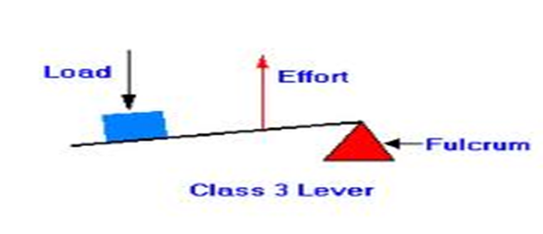
Levers
In order to produce movement your muscles and bones work together as a series of levers.
Levers involve:
Fulcrum (pivot) – the point about which the lever rotates (the joint involved).
Resistance (load) – the load that is being moved.
Effort – the force applied by the person (the muscle that is the agonist).
Thinking of the bicep curl – what would be the fulcrum, the effort and the load?

Slide 2
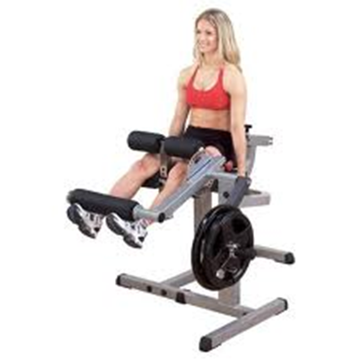
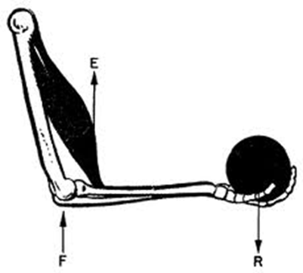
Classification of Levers
First Class – fulcrum in the middle.
Second Class – resistance in the middle.
Third Class – effort in the middle.
Remember FREE (minus an E of course!)

Slide 3
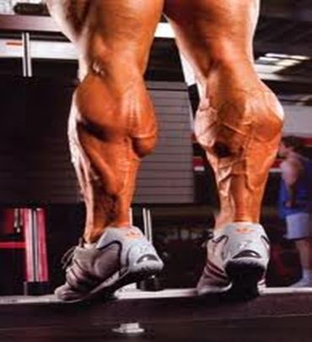
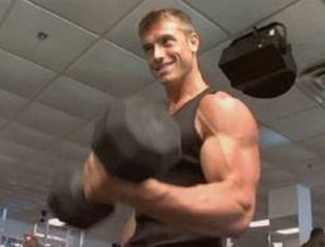
Which type of lever?

Slide 4
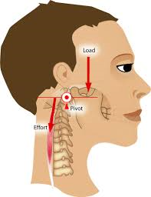
First Class Lever
Fulcrum in the middle.
E.g. nodding your head (pivot joint where the skull meets the spine). Your skull is the resistance (load), the pivot joint is the fulcrum and the muscles in the neck provide the effort.
This type of lever is also found on a seesaw.

Slide 5
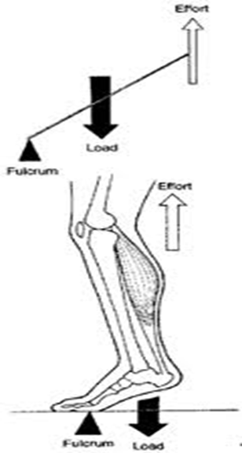
Second Class Lever
Resistance is in the middle.
E.g. the foot. During plantar flexion the ball of the foot acts as the fulcrum, the gastrocnemius provides the effort and the weight of the body is the resistance.
This occurs when jumping or running.
This type of lever is also found when using a wheelbarrow.

Slide 6
Third Class Lever
Effort is in the middle.
E.g. Nearly every joint in the body.
For example when performing a bicep curl the elbow is the fulcrum and the dumbbell is the resistance. The effort comes from the biceps which attach to the radius (between the fulcrum and the resistance).

Slide 7
Mechanical Advantages and disadvantages
Compare 2nd and 3rd class levers?
What are the advantages and disadvantages for each?
Think about how much weight they can move for the effort put in and what range of movement they offer.

Slide 8
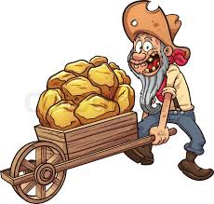
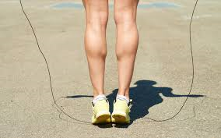
2nd class levers
Second class levers provide a mechanical advantage in that a small effort can be used to lift a large force. This is due to the resistance being close to the fulcrum and the effort being further away.

Slide 9
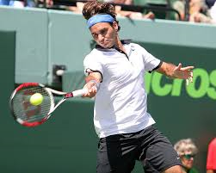
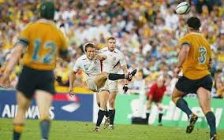
3rd class levers
Third class levers have the effort close to the fulcrum and the resistance further away from it. This produces a mechanical disadvantage in that a larger amount of effort is needed to move a given resistance.
However, this disadvantage is compensated for with a larger range of movement and greater speed of movement.
These levers are used in sports such as football when kicking a ball and racket sports.

Slide 10
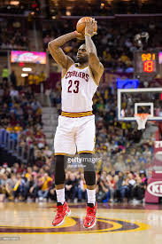
Exam question
Name, sketch and label the lever system operating at the ankle in the diagram below. What mechanical advantages and disadvantages does this type of lever provide? (6 marks)

Slide 11
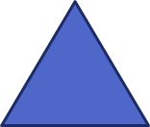
answer
Second class lever
Mechanical advantage in that a small amount of effort can produce a large amount of force to allow Lebron to jump in the air
Mechanical disadvantage in that only a small amount of movement is produced at the ankle joint.

Slide 12
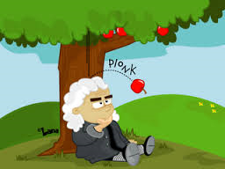
Newton’s laws of motion
Newton’s laws of motion describe the rules by which things move or stay stationary. They are often thought to be complex but are remarkably simple.
You must be able to describe each law and relate it to a sporting situation.

Slide 13
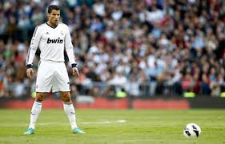
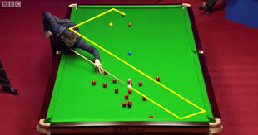
Newton’s first law
The law of inertia
‘an object will remain at rest or in uniform motion unless acted upon by an external force.’
(inertia means reluctance to change the state of motion)

Slide 14
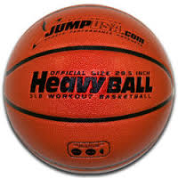
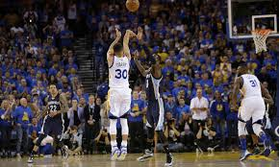
Newton’s second law
The law of acceleration
‘The acceleration of an object by a force is directly proportional to the magnitude of the force, in the same direction as the force and inversely proportional to the mass of the object.’ (F = M A)
How could this law be applied to a sprinter pushing off the blocks?

Slide 15
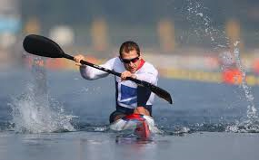
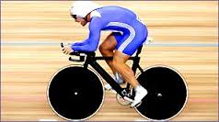
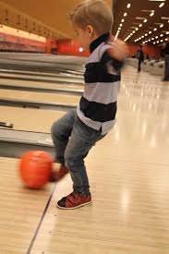
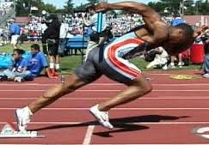
Newton’s third law
The law of action / reaction
‘for every action there is an equal and opposite reaction.’
Explain how this law can be applied in the diagrams below.

Slide 16
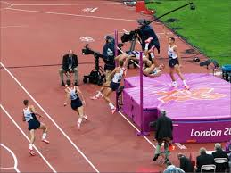
Exam question
Use newton’s 3 laws of motion to describe the take off phase of a high jumper. (6 marks)

Slide 17
answer
Newton's first law – the law of Inertia – a force is needed to change a body’s state of motion.
The athlete must push down into the ground in order to change the state of motion from horizontal to vertical.
Newton's third law – for every action there is an equal and opposite reaction.
To drive the body upwards the athlete must produce an action force into the ground.
This produces a ground reaction force.
Newton's second law – the magnitude and direction of applied force determines the magnitude and direction of acceleration.
The more force that the athlete pushes down with, the more force with which they are pushed upwards.
The athlete pushes down into the ground in order to move upwards over the bar.
The greater the mass of the athlete, the more force they would have to apply

Slide 18
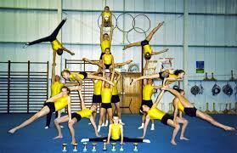
Task
Using a balance cushion try to pick up an object from the floor 1m to your side (left or right). What difference does it make if:
You keep your legs as straight as possible?
You have two feet on the cushion?
You have one foot on the cushion?
What technique do you use to reach the furthest?
What conclusions can you draw from this about stability?

Slide 19
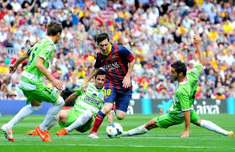
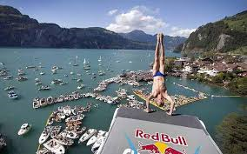
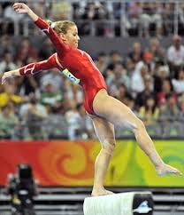
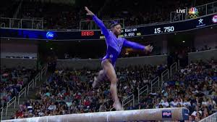
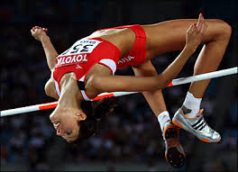
Stability and Centre of Mass
Centre of mass is the single point which represents all the spread out mass of a body. It is the point of balance of the body. As limbs are moved the centre of mass moves.
Where is the centre of mass on the pictures below?
When the centre of mass is over the base of
support an object is in equilibrium.

Slide 20
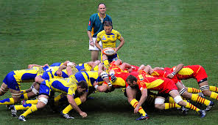
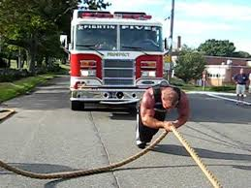
Calculation of force
What is the definition of a force?
Force is a push or a pull – it changes the state of motion of an object.
Force is measured in newtons (10N = 1kg)
1n of force is required to produce 1m/s of acceleration in an object with a mass of 1kg.

Slide 21
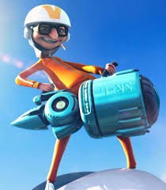
Vectors and scalars
A scalar has only one value – size (magnitude). Mass, speed and length are examples of scalars.
A vector has two values – size and direction. Force, acceleration, velocity and momentum are all examples of vectors.

Slide 22
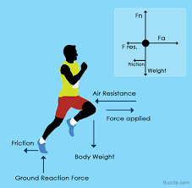
Net force
When there is more than one vector they must be
added together and their directions must be taken
into account.
The sprinter to the right has the vertical forces of weight (acting downwards) and ground reaction force (acting upwards).
Other forces such as friction and air resistance need to be taken into account.
What happens when forces cancel each other out? What is the net force? (think of newton’s first law)
What happens when they don’t cancel each other out? (think of newton’s second law)

Slide 23
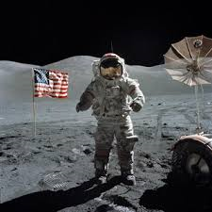
Weight and mass
Mass is a scalar – it is the total quantity of matter in an object.
Weight is a vector – it is the force due to gravity on a mass. On earth that is 10n for each kg of mass. A 50kg sprinter would have a weight of 500n pulling towards the centre of the earth.
On the moon the gravitational pull is 1.67n for each kg of mass. What would the sprinter weigh there?

Slide 24
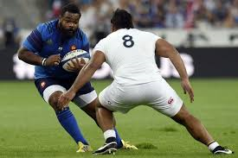
Exam question
Two rugby players go into a tackle. Player ‘A’ has a mass of 92kg and is accelerating at a rate of 2m/s. Player ‘B’ has a mass of 65kg and is accelerating at a rate of 3m/s.
Use newton’s second law of motion to:
Calculate the resultant force at the point of impact. Show your working (4 marks)
Identify which player the resultant force favours (1 mark)

Slide 25
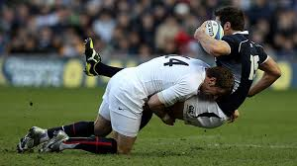
Answers
Newton’s second law of motion: force=mass x acceleration
Player A: f = 92 X 2 = 184n
Player B: f = 65 X 3 = 195n
Resultant force of 11n
B) Player B

Slide 26
Warm up
There are 4 aspects of a general warm up:
Pulse raiser
Stretching and mobility exercises
Sport specific skills
Psychological preparation
There are numerous benefits of a warm-up. Working with a partner can you list 7 benefits?

Slide 27
Benefits of warm up for the muscular system
Increased heart rate
Better oxygen delivery to muscle tissues and removal of carbon dioxide
Increased stroke volume
Increased cardiac output
Increased venous return
Release of adrenaline raises heart rate
Vascular shunting due to vasodilation and vasoconstriction allows for appropriate oxygen distribution
Increased speed of nerve conduction leads to faster muscle contractions
Reduction in likelihood of muscular injury due to increased blood flow and oxygen in muscles
Prepares tendons to further reduce injury risk

Slide 28
Benefits of warm up for the skeletal system
Improves skeletal flexibility leading to greater range of motion
Increases production of synovial fluid which reduces friction between joints
Control of anxiety / psyching up
Practice of skills involved
Focus mind
Psychological benefits of a warm up

Slide 29
Intensity and duration of warm up
This varies greatly dependant on the demands of the activity.
Generally The more anaerobic the activity the longer the warm up will be. Sports involving high skill levels will need to incorporate that into the warm-up.

Slide 30
Exam question
Explain the effects of warm up for muscle tissue. Why is it essential for a 400m hurdler to warm up prior to a race? (8 marks)

Slide 31
Answer
Warm up consists of a pulse raiser, sports specific stretches, skills practice and psychological preparation
Warm up increases heart rate leading to greater oxygen delivery to muscles
Increase in stroke volume, cardiac output and venous return
Release of adrenaline further increases heart rate
Vascular shunting
Vasodilation of arterioles supplying the working muscles (e.G. Quadriceps)
Vasoconstriction of arterioles supplying less vital areas (e.G. The digestive system)
Increased speed of nerve conduction for faster muscle contractions and thus faster sprinting
Increased o2 delivery to muscles reduces injury risk

