Slide 1
Types of Muscle Fibre
Learning Objectives:
To know the structural and functional differences between fibre types.
To know how muscle fibre type affects sporting performance.

Slide 2
Order the numbers into the Sliding Filament Theory
Myosin detatches and reattaches further along pulling actin in with a ratchet-like mechanism.
Myosin ATPase is activated causing ATP to breakdown and energy to be released.
The sarcoplasmic reticulum stores calcium at ions at rest.
A nerve impulse arrives at the neuromuscular junction.
The calcium ion binds to troponin, making the binding site on actin available for myosin to bind.
A strand wrapped around actin prevents myosin attaching.
The nerve impulse triggers the release of calcium ions from the sarcoplasmic reticulum.
The energy causes the myosin to pull the actin in.

Slide 3
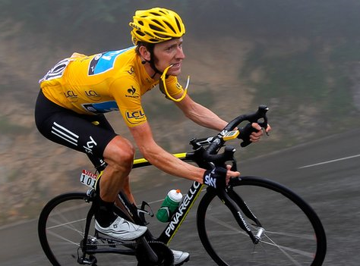
Slow Twitch Fibres (Type 1)
Contract relatively slowly.
Small in size.
Produce less force.
Greater number of blood capillaries delivering O2.
Therefore, greater aerobic capacity and do not fatigue quickly.
Produce energy from aerobic pathways.
Recruited during low intensity endurance events.

Slide 4
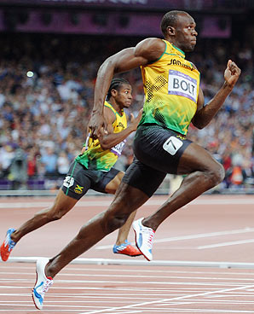
Fast Twitch Fibres (Type II)
Contract with greater speed.
Produce more force due to more myosin filaments which are also thicker.
More developed sarcoplasmic reticulum (releases and removes Ca ions more quickly for faster contractions.
Contain different myosin ATPase which releases energy more quickly.
Produce energy from anaerobic pathways.
Fatigue quickly.
Suited to short, intense burst of effort (sprinting activities).
The different types of runners (fibres).

Slide 5
Different Fast-Twitch Fibres
There are in fact at least 2 different types of fast-twitch muscle fibres:
FAST TWITCH TYPE IIa (Fast Oxidative Glycolytic – FOG)
Used in short, high intensity endurance activities – e.g 1500m run
FAST TWITCH TYPE IIb (Fast Glycolytic – FG)
Used in highly explosive events – e.g 100m sprint
Type 1 fibres have 1/10th maximum contraction velocity of Type IIb fibres. They also produce less maximum force.
Type IIa fibres are between the Type 1 and Type IIb for maximum contraction velocity and maximum force production.

Slide 6
Key features of Type IIx Fibres
Increased ATP stores enable greater power for contraction of muscles
High levels of PC stores enable the muscle to work at greater speed of muscle contraction / power.
A high level of PC stores enables the ATP-PC system to last longer.
Higher glycogen stores enable the athlete to maintain a high power output / speed for longer / energy.
Large motor neurons enable a faster speed of contraction.
Higher force production enables greater power output.
Higher level of anaerobic enzymes allows better energy production in the ATP-PC and glycolytic system.
They have a larger diameter/ size and therefore can produce more force/ power

Slide 7
Explain how type 2X muscle fibres are suited to sports that require sprinting. (5)

Slide 8
Explain how three of the structural characteristics of slow twitch muscle fibres enable the fibres to be better suited to endurance activities. (6)

Slide 9
Explain how four different characteristics of fast glycolytic (type IIx) fibres enable them to be better suited for power activities. (4)

Slide 10
Muscle Fibre Percentages
Athlete | Muscle | % Slow twitch | % Fast twitch
Sprinter | Gastrocnemius | 25 | 75
Marathon runner | Gastrocnemius | 75 | 25
Swimmer | Deltoid | 67 | 33
Shot-Putter | Gastrocnemius | 38 | 62
Non-athlete | Quadriceps | 47 | 53
Success in sprint events is influenced by the percentage of FT fibres an individual has (heredity), but it is also influenced by factors such as lever length (Bolt) and motivation.

Slide 11
FIBRE TYPE and EXERCISE
RECRUITMENT
based on intensity of exercise
at low intensity ST motor units recruited first
at higher intensity FOG FT IIa motor units recruited
at greatest intensity FG FT IIb motor units recruited to produce powerful fast muscle contractions
all available fibres are recruited for all power activities

Slide 12
Responses to Training
% of fast/slow twitch muscle fibres is genetically determined – typically around 50/50.
Endurance training results in type IIx being converted to type IIa.
(explains why long steady training results in loss of speed)
Endurance training increases the aerobic capacity of ST fibres.
(due to greater capilliarisation and increased supply of O2)

Slide 13
Effects of aerobic training
TYPE 1 | TYPE 2a | TYPE 2b
Before Training (Average person – 50/50 ST/FT)
50% | 25% | 25%
After Training (Average person – 50/50 ST/FT)
50% | >25 (e.g 30%) | <25 (e.g 20%)

Slide 14
Explain how three structural adaptations cause a corresponding functional response in skeletal muscle as a result of power-based training. (6 marks)
Increased myofibril response hypertrophy / muscle mass increase fibre size
Leads to: increased strength / power / force production of contraction
Increased levels of ATP and PC within the muscle
Leads to: Athlete can exercise for longer before feeling effects of fatigue
Increased activity of enzymes responsible for breakdown of ATP and PC / more anaerobic enzymes
Leads to: Faster breakdown of ATP and PC for faster contractions
Increased muscle elasticity
Leads to: Increased ROM /reduction in injury risk
Increased capillary network
Leads to: Better delivery of Oxygen/ gas exchange

Slide 15
Effects of Strength training
TYPE 1 | TYPE 2a | TYPE 2b
Before Training (Average person – 50/50 ST/FT)
50% | 25% | 25%
During Training (Average person – 50/50 ST/FT)
50% | >25 (e.g 30%) | <25 (e.g 20%)
After Training (Average person – 50/50 ST/FT)
50% | <25 (e.g 20%) | >25 (e.g 30%)

Slide 16
Identify four muscular-skeletal adaptations of the body to weight training, using heavy weights and few repetitions. (4)

Slide 17
Explain how three structural adaptations cause a corresponding functional response in skeletal muscle as a result of power-based training. (6)

Slide 18
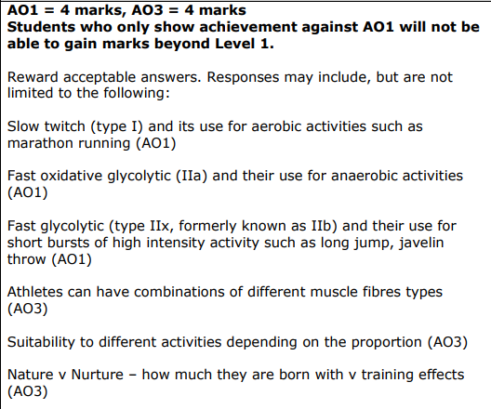
Using examples, evaluate why muscle fibre types make athletes suitable for different events. (15)
CONTINUED….

Slide 20
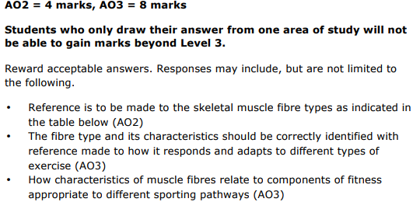
Analyse the view that muscle fibre make up dictates a person’s sporting pathway. Use your knowledge and understanding from across the course of study to answer this question. (12)
Continued…..

Slide 21
Continued

Slide 23
Task
Explain the sliding filament theory in your own words.
A nerve impulse arrives at the neuromuscular junction.
A strand wrapped around actin prevents myosin attaching.
The sarcoplasmic reticulum stores calcium at ions at rest.
The nerve impulse triggers the release of calcium ions from the sarcoplasmic reticulum.
The calcium ion binds to troponin, making the binding site on actin available for myosin to bind.
Myosin ATPase is activated causing ATP to breakdown and energy to be released.
The energy causes the myosin to pull the actin in.
Myosin detatches and reattaches further along pulling actin in with a ratchet-like mechanism.

