Slide 1
2.1 Elite Performers- The route
What is the sports development continuum?
What strategies exist for advancing people along the continuum?

Slide 3
Sports Development Continuum
Excellence
Performance
Participation
Foundation
Used to describe/identify level of performance
Highest number at base (Foundation level) as each step gets harder and requires more commitment, some people may not have the opportunity, provision or esteem to move up the continuum.

Slide 4
Sports Development Continuum
Stage | Description | How to reach next stage
Foundation | Lowest stage with the most people at the stage. Participants get their ‘first taste’ of sports, low skill level, played for fun or as part of compulsory PE, early development of physical competence | Choose to participate in a sport in their own time. Improve skill level, have desire to improve
Participation | Commitment of time to activity, sport undertaken primarily for fun but more emphasis on improving, may play low level matches e.g. extra curricular clubs | Need to keep practicing to improve skill level, join competitive club to play matches
Performance | Organised sport, good level coaches aiming to increase skill level, may be club or county level, regular training and matches | Be selected to training academies, work way up NGB pathways, be selected by TIP
Excellence/Elite | Top level- smallest number of people, highest level coaching and technical support, commitment, national or international

Slide 5
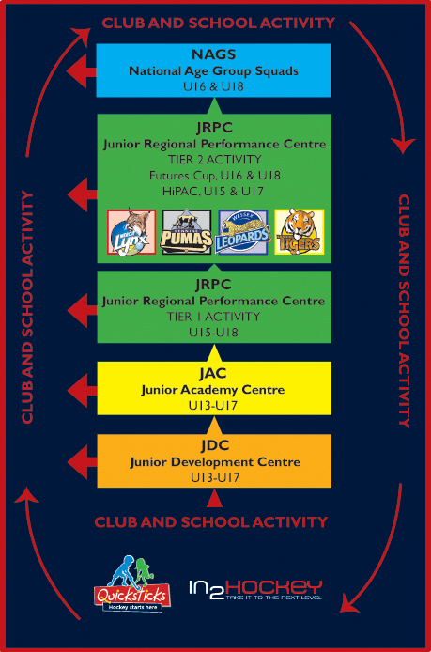
England Hockey
Excellence
Performance
Participation
Foundation

Slide 6
How and Why do we create such a large base (foundation) level?
National Governing Bodies are responsible for increasing participation in their individual sport. They aim to create the largest base possible for many reasons:
A large base means more talent potential- more people will move up the continuum increasing ability of elite performers
National lottery funds sports with more participants involved, so NGBs aim to increase foundation level as one way to get more money.
Benefits
Personal health benefits- physical (improved health, improved fitness, decrease chance of exercise related illnesses e,g osteoporsis, increased strength), mental (decreases stress, releases serotonin- feel good factor), social (make and interact with friends, learning cooporation)
Community benefits- keeps people busy, increases moral, decreases crime that may be caused to boredom

Slide 7
Talent Identification Programmes (TIPs)
Having a large foundation won’t help unless there is a way of finding those with enough talent to make it to the top. Different sports have different success with their Talent Identification Programmes
Some sports require participants with specific physical attributes, a good example is rowing- rowers need to be tall with particularly long limbs for extra reach, the cox who is in charge of the boat has to be small and light to not put extra weight on the boat.
Talent Identification Programmes are a great way of introducing people to sports that they may not have tried before but they may suit.
They can also ‘fast track’ talented performers to help move them up the sport development continuum so that the receive the best levels of coaching and support early on in their career.
NGBs have primary function to put this in place.
Work with schools and clubs to set up local and regional TIPs
Additional talent searches such as Discover Your Power

Slide 8
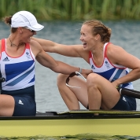
Talent identification success story
HELEN GLOVER
LONDON 2012 GOLD MEDALLIST
Helen started rowing in 2008 through the UK Talent Team (UK Sport and English Institute of Sport) Sporting Giants scheme and was placed on to the GB Rowing Team's Start programme, sponsored by Siemens, in Bath and coached by GB Rowing’s Paul Stannard. Prior to this she had absolutely no experience with rowing.
http://www.uksport.gov.uk/our-work/talent-id/athlete-success-stories

Slide 9
TIPs – The Criticisms You need to be able to identify the strengths and limitations of TIPS
Use of physiological data to select youngsters, favours those who have developed early, someone may miss out due to a late growth spurt
Use of current performance levels at early as an indicator favoured those who had best opportunities- supportive parents, specialist coaching at school etc.
Can result in over-specialistation at a young age, linked to high drop out rates.
Few TIPs used any psychological testing despite the links to progression
Most focused on whether the performer currently had the skills not whether they had the potential to learn further
Emphasis on success leads to confusion between current performance and talent (potential). If funding only goes to ‘best’ juniors then lots of wasted talent.

Slide 10
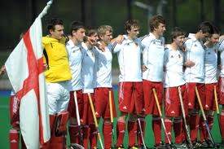
Providing the development structure
To enable a performer to move through the stage of the pyramid...
Opportunities to play at a higher level
Structured layers of competition (Leagues)
Representative structure
Through selection processes
Can play for district, region or country
Development squads linked to TIPs
Bringing together the best performers
Most potential
Give them high quality coaching and training

Slide 11
Supporting performer development
Providing necessary levels of support...
Financial
Technical
Psychological
UK clarified it’s systems of support with the main responsibility belonging to...
NGBs
UK Sport
English Institute of Sport
Sports Councils of Wales, Northern Ireland and Scotland
British Olympic Association
Sports Coach UK
Sports Aid

