Slide 1
Social and Cultural factors required to support progression
What physical, social and cultural characteristics are required to progress to elite?
What barriers are in the way of people progressing?

Slide 2
Family
Factors to be considered…
Is there support from their family? Financial and emotional
Is there high status of sport within family or community?
Did they have positive experiences of sport at school?
How are Personal socio-economic status- Are financial resources available?
Does the country prioritise high level sport?
Is there an Infrastructure for elite performer development?- TIPs and LTAD
Is the positive media coverage of sport? Role models
Personal
Country

Slide 3
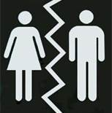
Sex or ‘gender’ discrimination
Sex- Biologically male or female
Gender- Culturally determined roles of males and females in society
https://www.youtube.com/watch?v=XjJQBjWYDTs – Like a girl
https://www.youtube.com/watch?v=f-UX0LE_tCg – Caster Semenya
Women’s progression to elite is affected by sexism.
Discriminated against due to stereotypical views on…
Strengths and qualities of women
Gender role that women are expected to fulfil in society

Slide 4
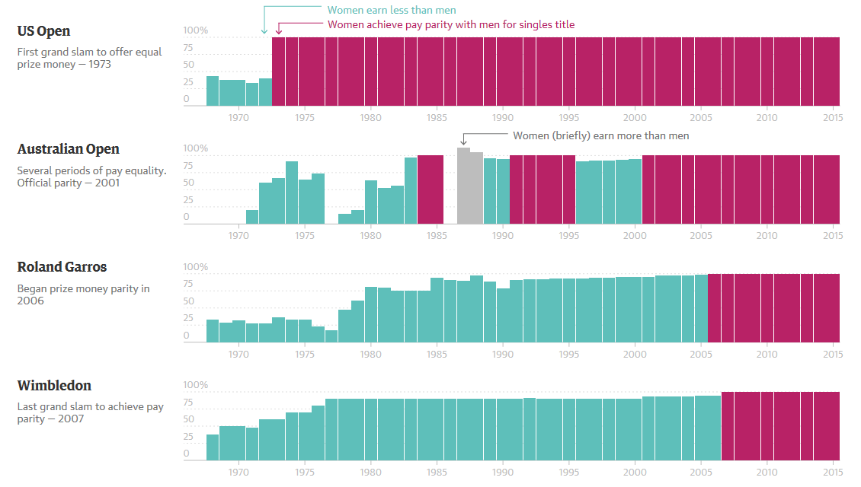

Slide 5
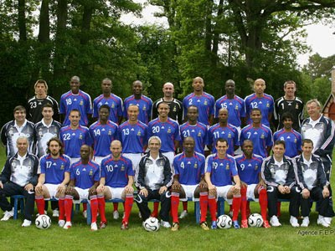
Racial discrimination
More mixed here from AS- we are looking at progression not participation
Lack of representation in certain sporting fields...
Of all English footballers playing in the premier league
25% are from Caribbean or African origins
Almost none are Asian
Athletics is a similar story
Only 1 of the top 10 UK Tennis players is from a minority background. (M and F)
Why is there this variation?

Slide 6
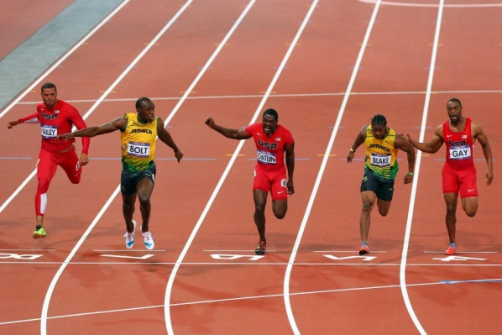

Slide 7
Assumptions on variation
UK Caribbean and African groups
Often attributed to physiological differences in sports needing speed / strength
Fast twitch muscle fibre
Higher muscle ratio
There are many sports which need these attributes
However
We don’t see this over-representation in activities such as Rugby or Swimming
Why not?

Slide 8
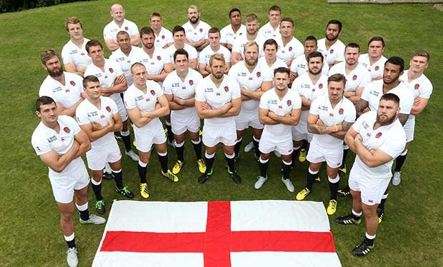

Slide 9
Why is there this variation?
Role model effect
Existence of high profile elite performers encourages others
May be pressured into certain activities- Pigeon holing
Based on belief they have a natural advantage
Athletic achievement is based on objective outcomes- Times, Distances etc.
Less opportunity to be over looked based on subjective opinions
Lower Socio-economic groups have high proportion of minority communities
Largest proportion of footballers and athletes come from these groups

Slide 10
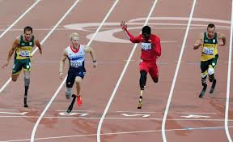
Disability
From AS it was clear that those with a disability are less likely to participate, but how likely are they to progress?
Is it possible to assume that there are fewer barriers to progression for disabled athletes?
Location | Olympic medals | Paralympic medals
Beijing | 47 (5%) | 102 (7%)
London | 65 (7%) | 120 (8%)

Slide 11
Support for Disabled athletes
British Paralympic Association (BPA)
Responsible for selecting, preparing, entering, funding and managing Britain’s teams
Athletes are funded by the normal route…
Exchequer funding
Lottery funding via World Class Performance plan
Sponsorship
Fundraising
Sport England’s ‘Awards for all’ look favourably on applications from disabled groups.
Talented Athlete Scholarship scheme (TASS)
Age limit extended to 35 for those with a disability
Common complaint is the lack of media coverage (Evident with London 2012)
Leads to lack of sponsorship
Media coverage often focuses on the disability rather than the quality of the achievement

Slide 12
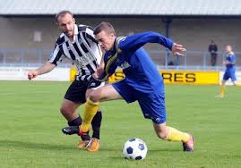
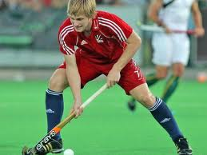
Social Class
Complex issue
Clearly a lack of financial support could be an obvious barrier to participation
However
Whether or not it is more difficult for someone to progress is another matter
Lack of disposable income and free time will be a huge barrier
Certain sports are very focused on unearthing talent- Professional
Resources will be available
Much more difficult for Amateur and Semi-professional sports
Lack the resources
More dependant upon lottery funding

Slide 13
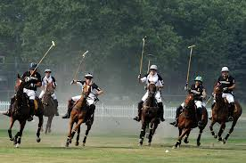
Factors affecting Social Class progression
Financial support provided by Exchequer and Lottery funding
Other factors
Physical activities associated with specific social classes
Golf
Polo
Sailing
Discrimination when competing in an activity outside their class norm
Could be prevented from participating
Membership applications
Leisure time
Less available and therefore less likely to participate in the first place
Little research for a definitive answer

