Slide 1
SportsAid

Slide 2
What is SportsAid?
SportsAid is a organisation that raises money to support talented young performers, or those with a disability not supported by national programmes such as the World Class Performance Programme.
SportsAid ensures that Britian’s young sport stars have the backing they need to reach a very high standard. SportsAid has distributed more than £30 million to athletes throughout Britain and gives around 2,000 awards every year.

Slide 3
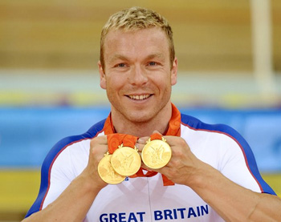
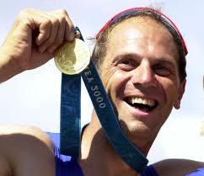
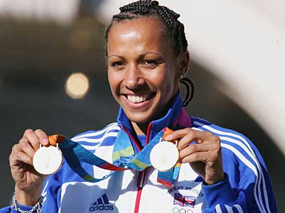
Who SportsAid help
SportAid help Young athletes who are both able-bodied and those with a disability, they are nominated to SportsAid for financial support by their sport’s own national governing body (NGB).
SportsAid is a proven process that makes a genuine difference. At the 2008 Olympics in Beijing, 18 of Britain’s 19 gold medals were won in events that involved SportsAid athletes.
Many of Britain’s most successful athletes have been supported by SportsAid such as:
Chris Hoy
Steve Redgrave
Kelly Holmes

Slide 4
Who SportsAid work with
Talented Athlete Scholarship Scheme (TASS) – Helps maintain a good balance between academic life or employment whilst training and competing as a performance athlete.
UK Sport - Works in partnership to lead Olympic and Paralympic sport in the UK to World Class Success
Sport England - Sport England is focused on the creation of a world-leading community sport system.
English Institute of Sport - Works in partnership with sport to improve performances through the delivery of high quality sport science and medical support to elite athletes.
British Athletes Commission – Acts as the unified voice of all Olympic, Paralympic and World Class funded athletes. It communicates their views to the major decision makers within British sport, and promotes athlete representation within their sports.

