Slide 1
1.1 World Games
Section C – Contemporary influences in sport and their impact on the performer
Section 1 explores the concepts and characteristics of World Games and their impact on the state and the individual.
What are the characteristics of World Games?
What impact do World Games have on the individuals, country and government?

Slide 2
World Games
Level of competition engaged in by elite performers beyond their own national boundaries.
Coming together of elite athletes and teams to compete at:
World level
Continental level
Regional level
Single Sport | Multi-sport
Football- FIFA World Cup | Olympics
Hockey- Champions Trophy | Paralympics
Rugby- Heineken Cup | Commonwealth Games
Gymnastics- African Championships | Pan American Games
Badminton- IBAD (international Badminton association for disabled) European Championships | All- Africa Games

Slide 3
Characteristics of World Games
These will vary depending on the size and popularity of the competition
Rio Olympics 2016 11,303 athletes participated 207 nations Cost- over $12 billion | Netball World Championships 2015 192 athletes participated 16 nations Cost- $4 million
SISSEC Q

Slide 4
Characteristics of world games
Key Word | Description
Spectators | High levels of spectators, may be live or may be on television
Infrastructure Development | To meet demand of increase visitors host cities may need to improve their infrastructure. E.g. Improved roads and transport, Olympic village etc.
Sports facility development | Top level sports facilities needed to run event
Shop Window Effect | Acts as a ‘shop window’ to the rest of the world- a well run successful games will look favourably on nation, can boost tourism and economy- a poor games will have the reverse effect.
Elite Performers | Top level in their sport
Commercialisation, sponsorship and media involvement | Due to high levels of media interest in major world games athletes can receive considerable money from sponsors. Commercialisation- world games are ran to make money through media involvement and advertising.
Qualification | Athletes have to qualify to compete at a world games event, this may be a specific qualifying event, or may be through on=going results and trials.

Slide 5
Other key characteristics you need to be aware of…
World games are for able bodies and disabled athletes
Cultural/social benefit to the country- bringing together of the people inspired by the success of their athletes
Can be used to make a political statement
Often involve opening and closing ceremonies
Media coverage
Relies on having volunteers to help at the event (e.g. Olmpic game makers)

Slide 6
You need to know what the Impact of World Games are on…
Individuals | Country | Government

Slide 7
Impact on Individuals…
Performers are highly motivated to succeed:
They wish to compete against other elite performers to test themselves
They wish to fulfil their potential, to make the most of their abilities
They may be driven by personal gain, a desire to make a living as a professional performer
They gain pride and satisfaction from representing their country or nation
They strive to meet the expectations of family, peers, teachers or coaches
Spectators:
May have been inspired by role models
Spectators feel a pride in their country after successful international performances

Slide 8
Unfortunately there are many reasons that some may not make it to the world stage despite having all the necessary ability…
Individuals may lack the self-discipline needed to make the sacrifices needed.
They may not have sufficient motivation to keep pushing performance boundaries
They may not receive the necessary financial, coaching or technical support
Injury
They may decide on another career path
Temptation to break the rules – leading to a suspension

Slide 9
Impact on the County
Impact on the country can be split into cultural, social, economic
Cultural
Countries place significant emphasis on being successful; competitive sport seems to be part of their national character.
Demonstrated by the resources which are devoted to achieve
Reflected by the media
People who do well become national heroes
Social
Ability to unite a nation
Beijing – controversy over international criticism of government’s record of human rights. The nation united behind the current government.
National pride at hosting event

Slide 10
Country continued
Economics
Places country in the limelight- shop window effect
Encourages financial investment
Tourism
Stimulus for development of sports facilities
Increasing levels of participation
Infrastructure developments
Focus for regional regeneration
However many countries have suffered significant difficulties:-
Cost can far exceed revenue leaving debts to pay off- Montreal
Facilities end up unused- Wrong location or wrong design for long term
Construction delays in run up to event damaging India commonwealth games
If event doesn’t run smoothly brings negative press coverage

Slide 11
Government
Bids are generally supported by governments in the hope of bringing long term benefits to the country.
Can also be used to demonstrate the effectiveness of their political philosophy
USA and Russia during the cold war (60s and 70s)
Chinese government stated that Beijing would help with the development of human rights. (reportedly protestors were arrested)
A governments own future can be severely affects by hosting a world games:-
Increase in popularity after a successful bid/games
Unifying an un-popular government
Beijing- many Chinese supported the government after protestors affected torch relay
A government can lose support if the games are unsuccessful
Disruption to lives
Over spending leading to tax payments

Slide 12
It may be useful to have examples of controversial Olympic Games for use as examples in long answer questions

Slide 13
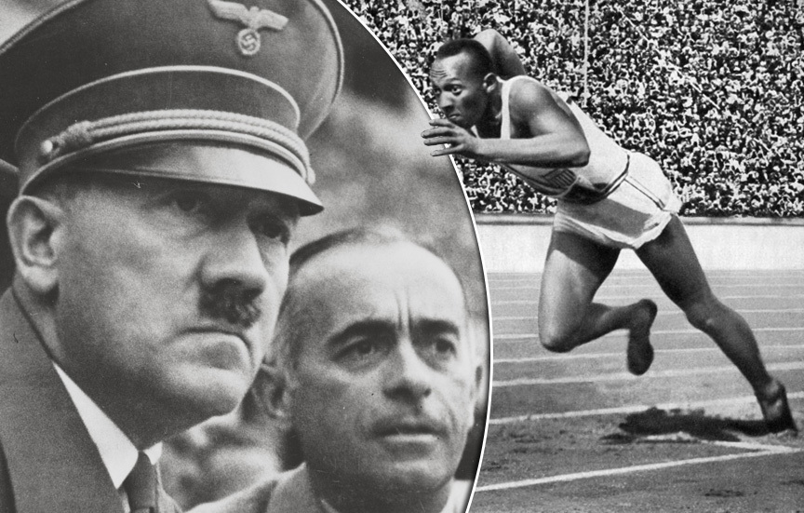
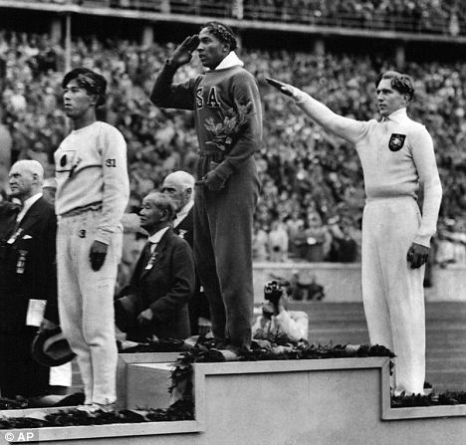
1936 Summer Olympics- Berlin
Berlin hosted the 1936 summer Olympics.
Reich Chancellor Adolf Hitler saw it as an opportunity to promote his government and ideals of racial supremacy.
The official Nazi party paper stated that Jews and black people should not be allowed to participate in the games.
After countries threatened to boycott the games he relented and allowed everyone to participate.
Germany added one ‘Token’ athlete to the team, Helene Mayer who had a Jewish father.
The party removed signs such as ‘Jews not wanted’ from around the city in an attempt to ‘clean up’ the games.
Jesse Owens, a black athlete from America won four gold medals at this Olympics.

Slide 14
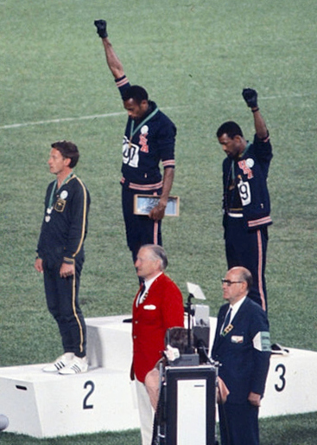
1968 Mexico City – Black Power Salute
US athletes Tommie Smith and John Carlos each raised a black gloved hand during the medal ceremony and kept them raised for the duration of the national anthem.
This was a political demonstration termed the black power salute.
They also didn’t wear shoes to receive their medals to represent black poverty.
All three athletes wore Olympic project for human rights badges.
They were booed by the crowd as they left the podium.
"If I win, I am American, not a black American. But if I did something bad, then they would say I am a Negro. We are black and we are proud of being black. Black America will understand what we did tonight.” Tommie Smith

Slide 15
1980 Moscow Olympics - Boycotts
Led by the United States 65 countries boycotted the 1980 Moscow Olympics because of the Soviet War in Afghanistan.
Some athletes from the boycotting countries participated under the International Olympic Committee flag.
Many of the boycotting nations took part in the Liberty Bell Classic, also known as the Olympic Boycott Games in Philadelphia.
This led to a return boycott by the Soviet Union of the 1984 Los Angeles Summer Games

