Slide 1
1.1 Rational Recreation and Amateurism
What were the early stages of sport development in the UK?
How has the status of amateur and professional sportspeople changed?

Slide 2
Development of Sport in the UK
To understand how sport has developed.
Need to realise that sport is an important aspect of life within society,
As such, tends to reflect society.
Sport and society have gone through clear stages of development:-
Pre-industrialisation (Popular recreation)
Industrialisation
Rational recreation
Post Industrialisation

Slide 3
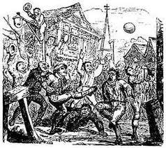
Pre-industrialisation
Shrovetide football
Popular Recreation was part of life before the industrialisation of the workplace
Different classes within society involved with very different forms of recreation.
Upper classes
Refined games with complex rules such as real tennis and fencing
Working class
Mob games- most lived rural lives dictated to by the farming season.
Recreation time tended to be in the form of Church holy days and festivals.
Characteristics of popular recreation:-
Local
Unstructured
Few rules
Violent
Played for participant not spectator
Limited equipment or facilities
Based on force not skill
Played occasionally (Festivals/holidays)

Slide 4
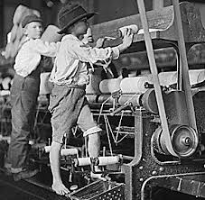
Industrialisation
From 1860 onwards society began to change, therefore so did sport.
Industrial revolution meant factories were employing thousands of people
People needed to live close so terraced housing was built
Little or no space for recreation in the urban areas
People worked 6 days a week and Sunday was day of rest
Participation in sport was expensive
Working class poorly paid and would take overtime when offered
Generally a lack of facilities for sport
Middle class factory owners established sports clubs
Means of maintaining social control
Church also provided land and organised teams

Slide 5
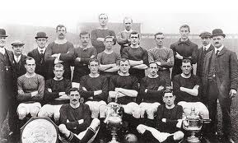
Industrialisation continued
Sport was seen as a way of improving health and loyalty within the workforce
Sponsorship/patronage of factory teams by their owners
During this period working conditions improved
Five and a half day week- Saturday afternoons available for recreation
Space at a premium so main involvement was as spectators
As wages increased so did disposable income
More could afford to watch and play sport
Railways developed and communication improved
Assisted the development of fixtures, competitions, leagues and more clubs
Spectator interest grew leading to professionalism along with media interest

Slide 6
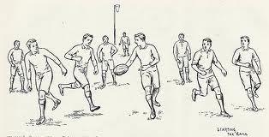
Rational recreation
As moral influence exerted by the middle classes increased so did idea of Fair Play
Three major contributors to the emergence of rational recreation:-
Codification Competitions Organisations
Codification- How it happened?
Public schools looking to develop discipline in their students.
Boys took their games into Universities and armed forces, establishing clubs.
Leading members of the clubs involved in standardisation of the rules.
Early formation of NGBs.
NGBs promoted development of regional and local organisations.
More competitions in place to increase number of games teams played.

Slide 7
Origins of professional football teams
Football team | Church
Aston Villa | Villa Cross Methodist church
Fulham | Fulham St Andrew’s Sunday school
Football team | Workplace
Arsenal | The Royal arsenal, Woolwich
Manchester United | Yorkshire and Lancashire railway company
Football team | School
Blackburn Rovers | Blackburn Grammar school
Tottenham Hotspur | St John’s Presbyterian school and Tottenham Grammar school

Slide 8
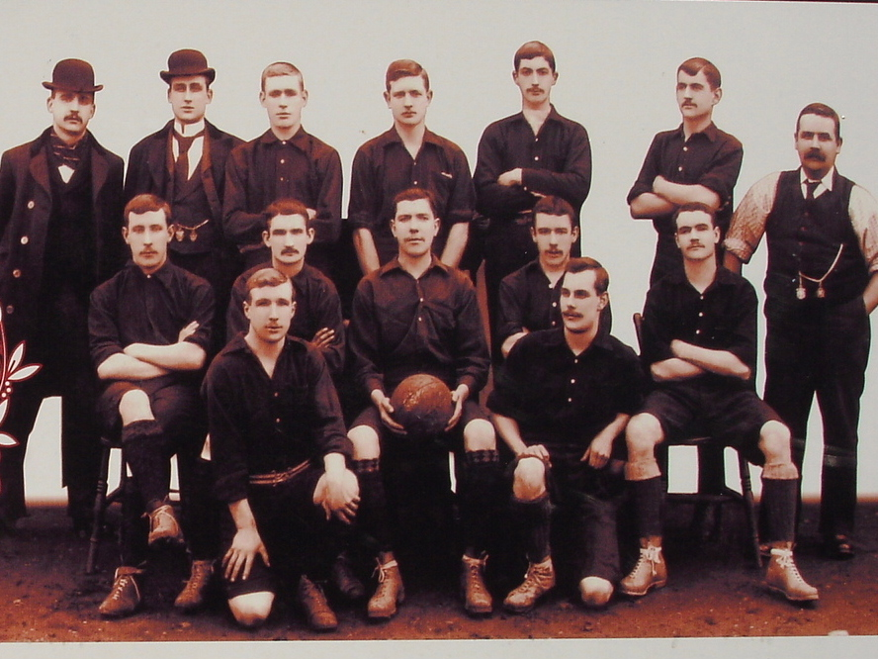
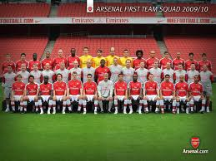
Dial Square FC
1886-1887
Became...
Arsenal FC
2011-2012

Slide 9
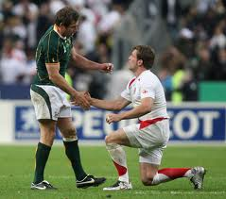
Public school ethos
Public school ethos of developing future leaders lead to the emergence of...
Athleticism
Combination of physical endeavour and moral integrity.
When public schools boys finished school and university...
Many went to teach or entered Clergy.
Encouraged more to join teams and helped spread sport.

Slide 10
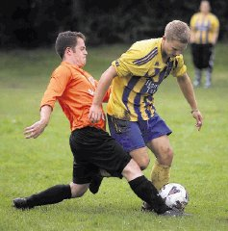
Amateurism V Professionalism
Individuals who played were keen to keep the class divide,
Using sport as social control
Clear distinction between amateur and professionals
A gentleman Amateur was from the middle/upper class
Played within rules of sport but also to a strict ethical code
Professionals were paid to play invariably from the working class
Employed to play sport
Distinction was reinforced through rules about membership
Rowing refused to let anyone involved in manual labour
Athletics association excluded ‘any tradesman, mechanic, artisan or labourer’
Upper classes managed to play sports how they wanted and keep working class out.

Slide 11
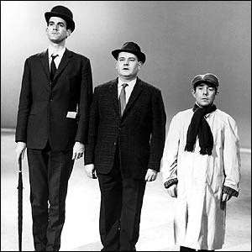
Class divide
The class divide was never more apparent than at this time...
Increasing affluence of middle and upper classes while working class remained poor
The professional performer in the 19th century had limited earning potential
Still better than normal wages
Middle and upper classes remained firmly entrenched in their amateur ways
Until late in the 20th century it was believed that...
Working class- Professional performer
Middle class- Agents, managers and promoters (Businessmen)
Upper class- Sponsors and Patrons

