Slide 1
2.2 Measuring anxiety
Revision Video- Part 2
What different methods are used to measure anxiety?

Slide 2
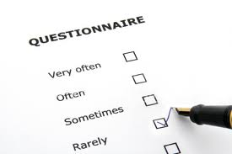
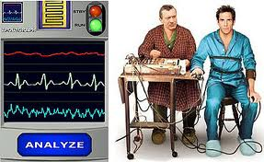
Measuring anxiety
Since anxiety has such a strong effect on performance…
Psychologists have devised methods to measure both State and Trait anxiety
These have taken different formats including:-
Physiological measures of Somatic anxiety (HR, Muscle tension and sweating)
Observation
Questionnaires
However several criticisms of these tests have emerged…
Physiological measures put the subject under extra anxiety, the situation itself creates anxiety.
Observations are subjective and are also in artificial environments causing extra anxiety
Questionnaires may not give a true reflection, but are popular as they are quick and cheap

Slide 3
Questionnaires
The three questionnaires typically used are…
The State-Trait Anxiety Inventory (STAI)- Spielberger, 1970
The Sport Competition Anxiety Test (SCAT)- Martens et al, 1977
The Competitive State Anxiety Inventory – 2 (CSAI-2) Martens, 1990

Slide 4
The State-Trait Anxiety Inventory (STAI)- Spielberger, 1970
Self report questionnaire
Gives an indication of both State and Trait anxiety
Limited use due to lack of relation to sport specific situations

Slide 5
The Sport Competition Anxiety Test (SCAT)- Martens et al, 1977
Self report applied to specific sporting situations
Gives an idea of the performers level of State anxiety in competitive situations
4 factors identified that relate to competitive anxiety...
Individual differences in how performers interact with different situations
Different types of anxiety (State and Trait) which they have experienced
A specific anxiety trait experienced only in competitive situations
The competition itself
Competitive Trait anxiety
Competitive State anxiety
Perception of threat
Competitive situation

Slide 6
The Competitive State Anxiety Inventory – 2 (CSAI-2) Martens, 1990
Uses self report to measure...
Cognitive state anxiety Somatic state anxiety Self confidence
Will be given out several times prior to competition
Discover baseline levels and compare with pre-competition levels
Cognitive State anxiety
Can be high along time before competition
Steady increase before competition
Will fluctuate during performance as chance of success/failure changes
Somatic State anxiety
Lower to begin with as body won’t react so soon
Increase quickly before competition
Generally decreases during completion

