Slide 1
2.3 Stress and Goal Setting
What is stress?
What are the benefits to goal setting?

Slide 2
Stress
Stress is a commonly used term in society and sport specifically.
Definition needs to be clarified as it has varied…
Stress- “Non-specific response of the body to any demand placed upon it”
Stress- “Negative response to a situation that places demand on us”
2nd definition is more specific to being ‘distressed’

Slide 3
Components of stress
Perception of your ability to cope
Perceived importance of the situation
Perceived demands of the situation
Perceived demands (Stressors)
Anything which…
Threatens our self esteem
Causes us personal harm
Develops for of the unknown
Causes frustration
Increases pressure
Individual Perception of stress
Trait anxiety
Self confidence
Interpretation of arousal
Significance of the event

Slide 4
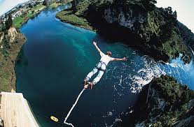
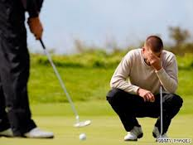
Responding to stress
Generally, Stress is something which is to be avoided as it inhibits performance
However, In some activities, stress appears to be an integral part of the activity…
Associated with thrill and excitement
Known as Eustress
The response of the body is directly proportional to the perception of the threat.

Slide 5
Fight or Flight
In threatening situations Adrenaline is released…
Can have both a positive and negative effect on performance
Increase heart rate
Increased Blood pressure
Increased oxygen delivery
Sweating increased to help keep muscles cool
Blood is diverted away from the skin
Attention focuses on threat (Selective attention)
Excitable, anxious, irritable
Reduction in ability to work as a member of a team
Difficulty executing precise movements
Inability to focus on different sources (Attention Narrowing)
Decision making reduced

Slide 6
Goal Setting
Stress management technique- directs attention away form threat and to an achievable target
Provides a direction for our efforts…
Improves selective attention
Increases motivation
Promotes task persistence
Increases self-confidence
Reduces anxiety
SMARTER
Specific
Measured
Agreed
Realistic
Timed
Exciting
Recorded

Slide 7
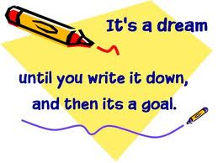
Types of Goals
Outcome
Fulfilling a particular result
Qualifying for a competition
Winning a specific game
Difficult to use as lots of elements outside of your control
Can increase anxiety if unsuccessful despite hard work
Performance
Judged against yourself or another
PB in athletics
Can be more realistic to you as not dependant upon others
Motivation maintained and often increased
Process
Concentration on specific technique- often influences performance goals
Concentrating on arm drive during running will improve performance
Concentrating on leg drive during drag flick will improve performance

