Slide 1
3.3- Hooliganism in sport
What is Hooliganism?
Where does Hooliganism take place?
What are the causes of Hooliganism?
What strategies are used to counter Hooliganism?
What are the affects of violence in sport?

Slide 2
What is Hooliganism? (1)
It is important to define the difference between hooligans, fans and supporters...
Supporters- can follow a team or national side without ever going to the games.
Fans- Travel to games but are there simply for the football.
Hooligans- Use a football match as a justification for abusive and violent acts.
Spectator violence has been a problem for football in the last 50 years.
Not just confined to the UK, it is very much a worldwide phenomenon.

Slide 3
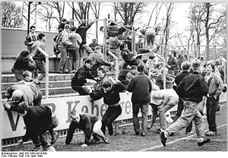
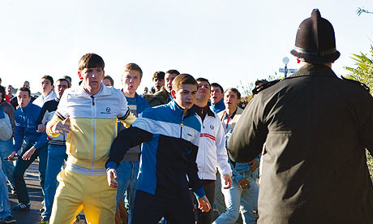
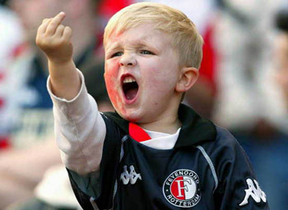
What is Hooliganism? (2)
What behaviour do we think of when we say Hooliganism?
Racist/Obscene chanting.
Fighting with other hooligan groups.
Vandalism and destruction of property.
Interference with match (pitch invasions etc).
Violence against non-hooligan groups.
Green Street- Final Fight

Slide 4
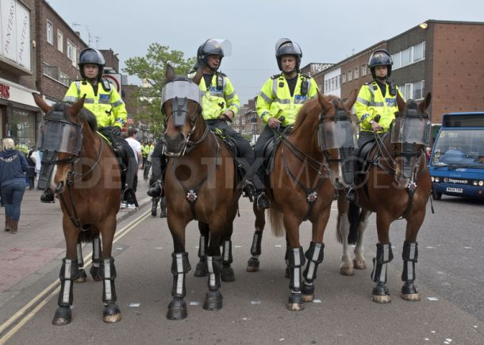
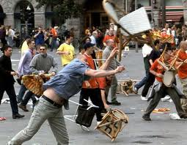
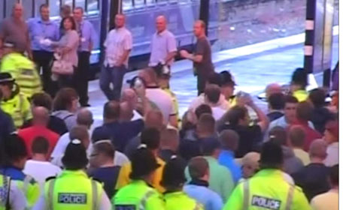
Where does Hooliganism take place?
Hooligan behaviour is normally...
Pre-organised
Alcohol fuelled
Looking for a conflict with the police
Large scale, herding effect.
For these reasons hooliganism tends to take place...
In football grounds and stadiums
In streets within vicinity of the ground
City centres
Local pubs
Public transport
Abroad when attending international matches

Slide 5
What causes Hooliganism?
The have been many suggestions, but none gives a full account...
Ritualised behaviour- Seen as a rite of passage and an expression of masculinity within a group.
Hooliganism goes beyond just males and isn’t always group orientated.
Outlet for young working class males who have aggressive tendencies.
Not all feel the need to and it isn’t just the working class involved with hooliganism
Tribal behaviour- Members proving themselves by protecting their ‘turf’.
Hooligans aren’t always local to their team and not the case in other sports.
Reaction to higher ticket prices and therefore more non-working class spectators in general, as well as loss of traditional working class jobs, unemployment and boredom.
Although spectator balance has changed there are hooligans who aren’t working class
Tension on the pitch can trigger a reaction by fans.
Passionate supporters in other sports don’t feel the need to engage in hooliganism.
Rivalry can inflame tension and passion, often increased by media stories.
Other sports can have derby matches without it leading to violence, supporters can sit together and even share banter.

Slide 6
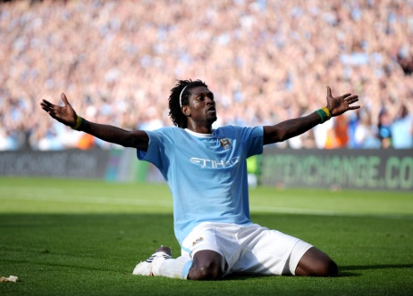
What strategies are used to counter Hooliganism?
During 70s and 80s hooliganism increased and became a real problem. The government, the FA and the police worked collaboratively to plan strategies to combat it...
Preventing known hooligans travelling to matches, banning or requiring them to report to police station during match times.
Control of alcohol- not serving within grounds or asking pubs to close early
Segregation of fans travelling to the game.
Introduction of all-seater stadium, reduces movement and avoids over selling of tickets.
Improved levels of stewarding and policing, improves crowd control.
Introduction of CCTV at stadiums, entrances to them and city centres.
Modern day face recognition software used by police to track known hooligans.
Sharing of police intelligence across the UK and abroad.
Not allowing players to gesture to the crowd
Banning of fans, fining clubs and playing games behind closed doors.
Using high profile role models to appeal against hooliganism

Slide 7
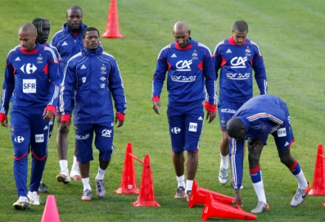
What are the affects of violence in sport?
Any violence brings the sport into disrepute and damages its ability to gain extra numbers at the grass root level with parents not wanting their children in contact with violence.
Legitimate fans will be kept behind while others are herding.
Players injured as a result of a deliberate foul
Players may have chance to play internationally limited in their team is not allowed to play at highest level.
Huge cost involved with policing of events is subsidised by tax.
Reputation of country can be negatively impacted.
National morale can be reduced if national team behave poorly.

