Slide 1
4.1 The Media
How has Elite sport become commercialised?
What affect has this had?

Slide 2
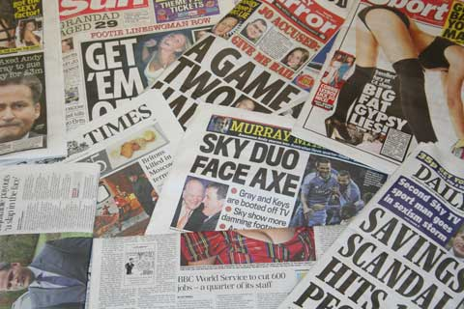
The Media
Media has completely revolutionised Sport
Historically has been seen in 2 main formats...
Television
Seen as the best as it has images and can transmit live
Satellite TV changed the way sport was broadcasted
Government have deemed it necessary to ring fence (Protect certain events)
Pay-per-view- Currently dominated by boxing but could easily expand
Newspapers
Both broadsheet and tabloid both cover sport but in different ways
Broadsheet- Less of paper focused on sport and greater variety of sports covered
Tabloid- Higher proportion of sport but less variety (Football dominates)
Now the internet era has developed this even further...

Slide 3
Commercialisation
Why is sport so popular?
Cheap form of entertainment- No actors etc.
Can be left for a few minutes without losing the ‘plot’
All elements of the best entertainment shows
Improvements in technology have encouraged development...
Action replays
SKY+
Sport Apps- BBC Sport, Sky Sports News etc.
The use of sport as mass entertainment encouraged the realisation that by selling their sport to the highest bidder they could make money.

Slide 4
The Golden Triangle
Sport
Business
Media
Televised sport offers businesses an investment opportunity
Premier League football rights worth in excess of £1.1Billion per year
Businesses can invest via sponsorship
Money in exchange for advertising
Very likely to create a profit
Endorsements of products
Giving a product publicity
Approval from a role model
Merchandising
Money back into sport for sale of associated products

Slide 5
The affect of commercialisation...
Requires...
Requires...
Media Coverage
Results in...
Results in...
Money
Results in...
Sponsorship

Slide 6
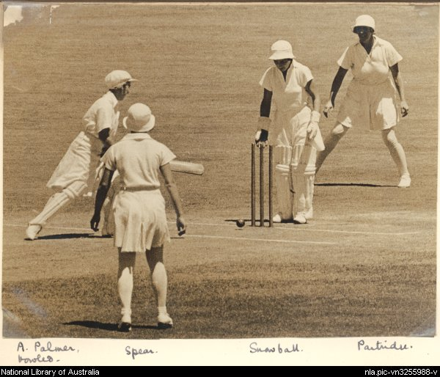
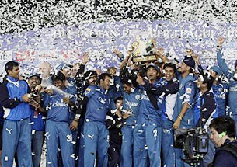
Making sport more attractive to the media...
Sport that is attractive to the media has the following characteristics...
High levels of skill and physical fitness
Well-matched competition
Demonstration of effort and overcoming challenges
Visual spectacle
Uncomplicated rules structure
Reasonable time scale
Traditional (?)
Identification of personalities and/or national relevance
Ease of Televising (Playing area and speed of play)
Some have undergone minor changes, others have been revolutionised...

Slide 7
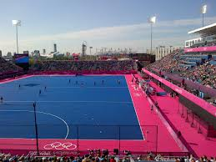
Effects on the coverage of sport...
Media coverage is now a necessary part of elite sport
Those who lack it struggle to keep going
NGBs may concentrate on more exciting events in their sport to create money
This can then be put back into grass roots level to increase participation
Tewenty-20 Cricket
Skiing- Giant Slalom event created as a middle ground to appeal to TV audiences
Changes to start times to ensure greatest number of spectators
Often to suit European timings
Structure of tournaments adapted
Football world cup has more teams qualify
More interest globally
Prolongs competition
US TV companies control Olympic broadcasting (Beijing)
100m Final ran at 10:30 local time (3.30pm in Europe and Breakfast time in USA)
Huge gender imbalance with Male sport dominating
Seen as more skilful and exciting

Slide 8
Is commercialisation of sport a good thing?
Yes
No
Provides an information service
Provides an entertainment service
Provides an educational service
Provides and advertising service
Aids sponsorship
Creates role models, personalities and heroes
Draws attention to top-level sport
Improves quality of sport?
Limits participation to a few male sports
Sensationalises issues
Highlights personalities rather than team
Possibility of boredom due to amount of coverage
Minority sports suffer due to lack of interest
Possible los of gate money
Needs of TV may dictate to sport

