Slide 1
A-Level Physical Education
Sports Injuries – Lesson 1

Slide 2
It has been suggested that 25% of injuries could be avoided if athletes took the correct preventive steps.
However, there are times when an injury is unavoidable and the performer must know how to return to full fitness as quickly as possible.

Slide 3
Objective
Understand how proper preparation can reduce the chance of injury.
Understand how training can reduce the chance of injury.

Slide 4
Preparation
Injuries can be prevented through preparation by;
Well-fitted and appropriate footwear.
Protective equipment
Clothing
Support for weak joints
Many of these strategies can be inexpensive.

Slide 5
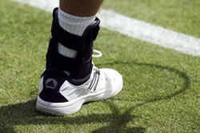
Joint Support
Players often use tape at joints to prevent ligament injuries.
Tape must be expertly applied in order to ensure optimal stability.
Taping and bracing can be used in the recovery process from injuries.

Slide 6
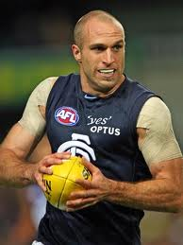
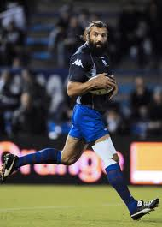
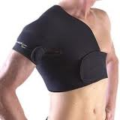
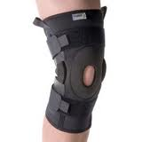

Slide 7
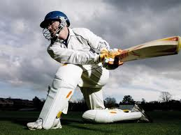
Protective Equipment
Mouth guards
Shin pads
Helmets
Body armour
Knee pads
Protective equipment is often worn by performers out of their own choice but some items are mandatory in sports.

Slide 8
Footwear
Shoes that don’t fit properly can cause;
Shin splints, hip injuries, lower back pain, Achilles tendonitis, blisters, runner’s knee.
Footwear also needs to provide sufficient friction against the playing surface.
However, too much friction/grip can result in anke and knee joint injuries.
“his studs got caught in the ground”

Slide 9
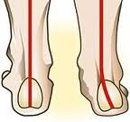
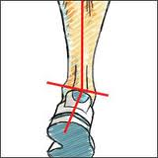
In order to ensure footwear fits sufficiently for optimal performance, the following need to be considered;
Shoe size
Arch of the foot
Gait analysis
How the individual runs.
Are they
Neutral
Pronated
Supinated.

Slide 10
For regular runners, it is well worth having your running analysed in order to buy trainers that are suitable.
Even as standard sports shoes such as football boots are available in a variety of designs, for different ground conditions and degrees of comfort, support, cushioning and protection.
An example of poor design in sports shoes is the “killer tab” which can cause Achilles injuries. The heel of trainers should be low cut to prevent this.

Slide 11
Clothing
…can help prevent sport-related injuries or environmentally related dangers by helping performers to keep cool, stay warm and deal with sweat.
Staying warm and dry is particularly important when taking part in outdoor activities when becoming cold and wet can increase risk of hypothermia.
It is important to keep cool and deal with sweat when taking part in high temperatures. The body has a natural process to prevent overheating by sweating but clothing made of synthetic, micro-fibre material also helps.

Slide 12
Training to Prevent Injuries
Training is used to increase performance – by improving strength, aerobic capacity, power etc.
However, training can also be used to reduce the risk of injury in an individual.
A major part of this training focusses on core strength/ stability.
Often referred to as “Prehabilitation”.

Slide 13
Strength & Conditioning
…will improve strength for performance and help minimise the risk of injury.
To do this, a program should be specific to the demands of the activity and contain a focus on common injuries.
Andreas Thorkildsen

Slide 14
Core Strength Training
Involves developing the deep trunk muscles, para-spinal muscles and pelvic floor muscles.
These help to stabilise the spine in the lower lumbar region.
During performance these muscles provide trunk stability before movement occurs.
Core strength conditioning can improve performance but also reduce the risk of lower back pain and injury.
This can be achieved through body-weight exercises, wobble boards and isometric exercises….as well as pilates etc!

Slide 15
Extended Learning
Research the effects of over training and consider how these could be avoided.

