Slide 1
Physiology Unit Structure
Term 1 | Energy Systems | Aerobic
 |  | Anaerobic
 |  | Lactic acid
Term 2 | Muscles | Structure
 |  | Fibre types
 |  | Sliding filament theory (how muscles contract)
 |  | Varying strength of contraction
Term 3 | Elite performers, Injury & Specialised Training | Water / electrolyte balance
 |  | Food supplements
 |  | Performance enhancing drugs
 |  | Injury prevention
 |  | Common injuries
 |  | Injury rehabilitation
 |  | Alternative methods of training
Term 4 | Biomechanics | Newtons laws
 |  | Application of forces

Slide 2
A2 Physiology Aerobic Energy System
LO: To be able to describe how glucose is broken down to produce energy when oxygen is present.

Slide 3
Adenosine Triphosphate (ATP)
The body transforms the food we eat into ATP.
When ATP is broken down it releases ADP + P + energy.
The body can resynthesise ATP by the reverse reaction: ADP + P + energy = ATP.
The body cannot store much ATP (only enough for about 2-3s of intense activity) so any energy required needs to be produced immediately.

Slide 4
Sources of Energy
ATP can be resynthesised from the breakdown of carbohydrates (into glucose), fats (into fatty acids and glycerol), and protein (into amino acids).
Excess glucose is stored as glycogen in the muscles and liver.
Glycerol can be converted into glucose when glycogen stores have been depleted (e.g. marathon).
At rest most of our energy comes from fats, during exercise energy is mostly supplied from carbohydrates.

Slide 5
Aerobic Energy Production from Glucose
When oxygen is present glucose can be broken down completely.
This occurs in the mitochondria and produces CO2, H2O, and energy (ATP).
The advantages of aerobic energy production is that there are no fatiguing by-products, the energy sources are usually abundant and lots of ATP can be produced.
The breakdown of glucose into energy (ATP) involves 3 stages: Glycolysis, Kreb’s cycle, and the Electron Transport Chain.

Slide 6
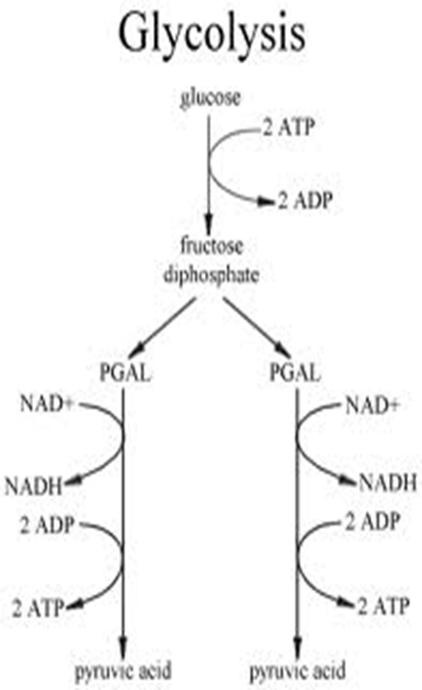
Glycolysis
The initial stage of glucose breakdown.
This stage is identical in both the aerobic and anaerobic systems.
Some complicated reactions take place but the basics you need to know are….
Pyruvic acid is produced (pyruvate).
2 ATP are used and 4 ATP produced, so there is a net gain of 2 ATP during this stage.
As well as ATP we also gain NADH, which becomes important at a later stage (Electron Transport Chain).

Slide 7
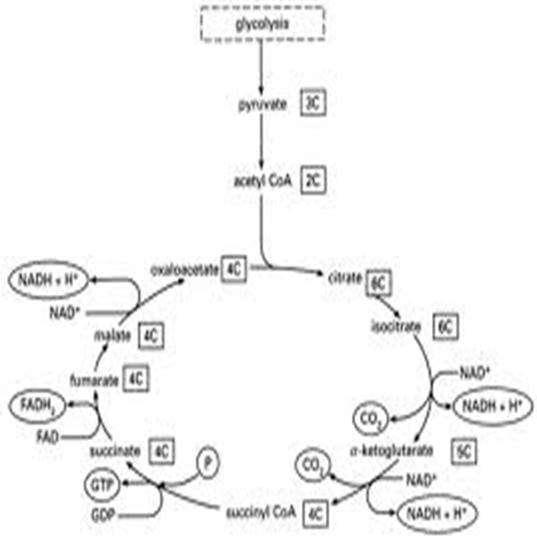
Kreb’s Cycle
This follow’s on from glycolysis, using the products from Glycolysis.
It only occurs in the presence of oxygen.
The pyruvic acid from glycolysis is added to coenzyme A, producing Acetyl Coenzyme A in preparation for the Kreb’s Cycle.
At this stage we gain another NADH for each Acetyl Coenzyme A.
Again, lots of complicated reactions take place but all that you need to know is that 2 ATP are produced.
In the Krebs cycle we also gain a further 6NADH and 2FADH₂

Slide 8
Electron Transport Chain
The final stage of glucose breakdown.
Once again, numerous complicated chemical reactions take place but all that you need to know is;
Large amounts of oxygen are required at this stage (thus it is aerobic energy production).
The NADH and FADH2 from previous stages are utilised here.
34 ATP molecules are produced.
So, at the end of these 3 stages 40 molecules of ATP are produced and 2 are used (net production = 38 ATP).

Slide 9
The Whole Process

Slide 10
GLYCOLYSIS
2ATP are used to split glucose into two 3-carbon molecules.
For each of the 3-carbon molecules, 2ATP and 1NADH are produced when forming pyruvic acid.
KREBS CYCLE
Pyruvic acid is not able to enter the Krebs Cycle, so coenzyme A is added to form acetyl coenzymeA.
For each acetyl coA that enters the Krebs Cycle 1ATP, 3NADH and 1FADH₂ are produced.
ELECTRON TRANSPORT CHAIN
The NADH and FADH2 molecules produced during Glycolysis and the Krebs Cycle enter the Electron Transport Chain, yielding 34ATP.

Slide 11
Aerobic Energy Production from Fat
Fatty acids are broken down by a process called beta-oxidation to acetyl CoA which enters the Kreb’s cycle (and eventually electron transport chain).
More ATP can be produced from fat than from glucose (during electron transport chain) but far more O2 is required.
Fat is therefore an excellent energy source at rest or low intensity exercise but cannot be used during high intensity exercise when a lack of O2 becomes a limiting factor.

Slide 12
Effects of Training on Aerobic Energy Systems
Cardiac hypertrophy and increased resting stroke volume (SV).
Decreased resting HR.
Increased muscle stores of glycogen and triglycerides.
Increased capilliarisation of muscle and increased number and size of mitochondria.
More efficient transport and effective use of O2 means that fat is used more during exercise (carbs saved for higher intensity).
Maximal oxygen consumption (V02 max) increases.

Slide 13
Oxygen Consumption (VO2)
The amount of oxygen used by our body is called oxygen consumption.
During exercise we need more ATP so O2 consumption increases.
Often when we begin exercise there is insufficient O2 available to produce ATP aerobically as it takes time for the body to adjust.
When 02 consumed is lower than 02 used, there is an ‘oxygen deficit’.
O2 consumption increases with exercise intensity until the point of max O2 consumption (VO2 max).

Slide 14
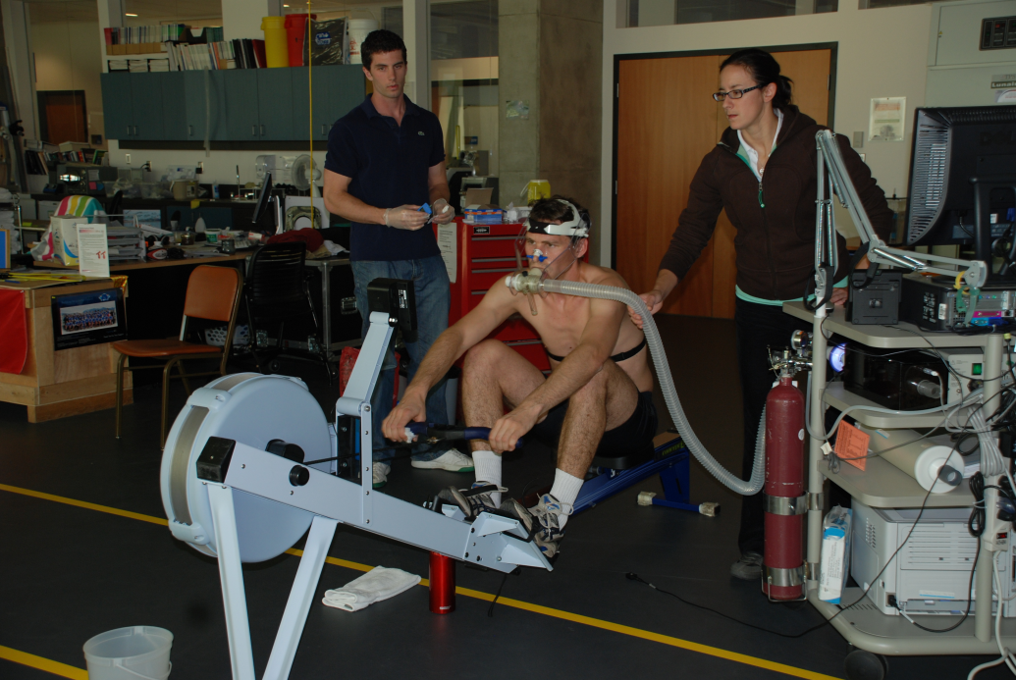
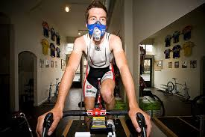
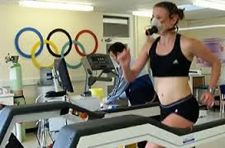
VO2 Max
VO2 max is the maximum amount of O2 that the body can consume and use.
A higher VO2 max means a higher level of aerobic fitness.
If exercise intensity is submaximal (below VO2 max) then O2 consumption reaches a ‘steady state.’ – O2 consumption matches O2 required.
VO2 max can be assessed by measuring amount of O2 consumed in comparison to amount of CO₂ breathed out during exercise with ever increasing intensity.

Slide 15
Factors affecting VO2 Max
VO2 max is the body’s ability to get O2 to the lungs, transfer it to the blood, transport it to muscle cells and mitochondria, and use the O2 in energy processes.
It is dependant on:
The surface area of alveoli (genetically determined)
Red blood cell and haemoglobin levels
The capillary density in the lungs
The efficiency of the heart and circulatory system
The capillary density in muscle cells
The transfer of O2 to mitochondria via myoglobin
The take-up and use of O2 by mitochondria

Slide 16
Exam Question
Describe the changes that occur in the body to make the aerobic energy systems more efficient following prolonged endurance training. (4 marks)
Cardiac hypertrophy – larger heart creates a stronger contraction (pump).
Increased resting stroke volume – volume of blood leaving the left ventricle per beat.
Decreased resting heart rate – number of beats per minute at rest.
Increased blood volume and haemoglobin levels – higher volume of oxygen able to be transported at one time.
Increased muscle glycogen stores – greater amount of glucose available for energy production from converted glycogen.
Increased myoglobin content in muscles – greater initial receptors of oxygen from the circulatory system before it is transported to the mitochondria.
Increased capilliarisation of muscle – more O2 can be diffused into working muscle from circulatory system.
Increased number and size of mitochondria – more ATP can be resynthesized in the muscle cell.
Resulting increase in VO2 max overall (maximal oxygen consumption).

Slide 17
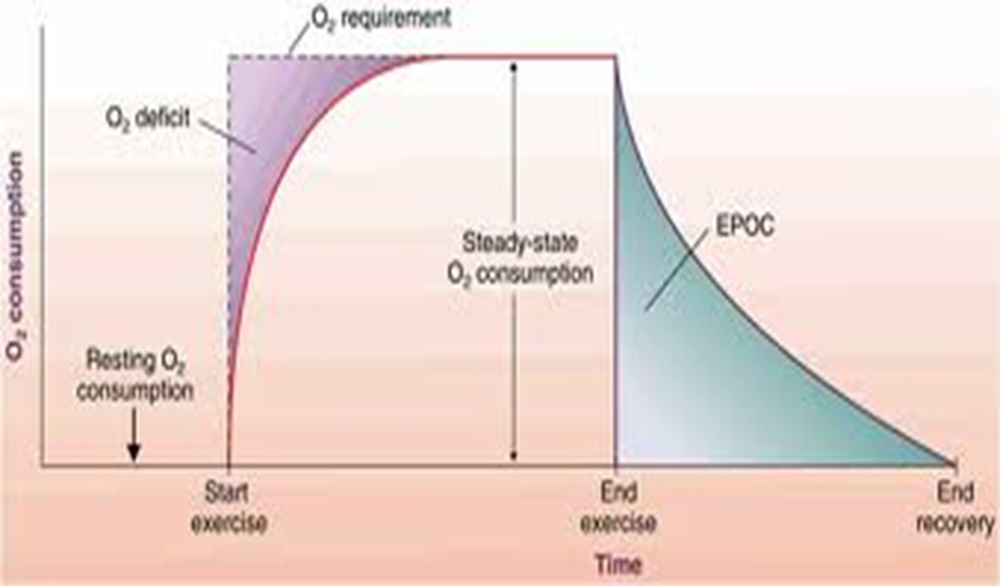
O₂ Consumption – Rest & Exercise

Slide 18
Post Exercise
Following exercise, bodily processes do not immediately return to resting levels, especially after intense exercise.
Consuming O₂ at higher than resting levels after exercise is called Excess Post-exercise Oxygen Consumption (EPOC). There are 2 components:
Fast (alactacid) component
O2 used to resynthesise ATP and phosphocreatine levels, re-saturates myoglobin (which transports O2 from blood to muscle fibres). This component will be very short after highly aerobic exercise.
Slow (lactacid) component
O2 used to remove lactic acid.

Slide 19
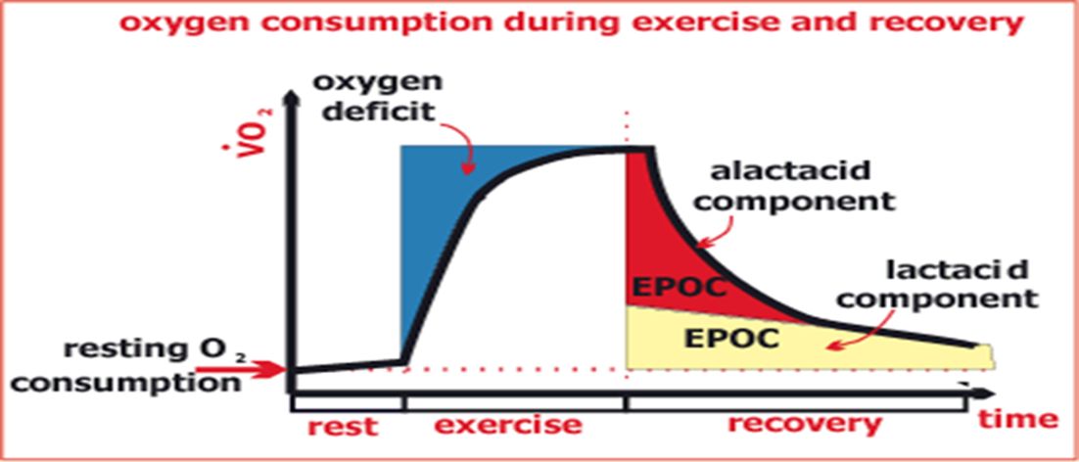
EPOC
During the alactacid (fast) component 75% of PC stores are restored within 1min and nearly 100% in 4mins. It takes 2mins to reload myoglobin with oxygen.
The removal of lactic acid (slow component) can take up to several hours.
As O2 is vital during these processes it is essential to perform a cool down – breathing rate is raised slightly above resting level to ensure more oxygen is provided.
Fitness levels along with exercise intensity levels determine the duration of EPOC.

Slide 20
Exam Question
During recovery from exercise, Excess Post-exercise Oxygen Consumption (EPOC) occurs. Explain the differing functions of the fast and the slow components of EPOC, and how EPOC varies with intensity of exercise. (7 marks)
Fast component - resynthesis of ATP / PC levels;
Alactacid component
Resaturation of myoglobin with oxygen
75% PC restored within one min, 100% within 4 mins;
Slow component - removal of lactate / lactic acid;
By oxidation / energy production;
Conversion to replenishment of glycogen (glucose) by reconverting lactic acid into pyruvate and continuing through the aerobic processes of Kreb’s cycle and electron transport chain;
Some converted to protein / some excreted in sweat and / or urine;
Oxygen used to maintain high work rates of heart / breathing muscles;
Extra oxygen used as temperature remains high;
More recovery time with higher intensities;
Greater oxygen consumption with higher intensity;
EPOC is larger with higher intensity.

Slide 21
At the 2008 Beijing Olympic Games, David Davies won the silver medal in the swimming 10 kilometre marathon event, in a time of 1 hour 51 minutes and 53.1 seconds. Explain how the majority of energy used during the race would be provided. (7 marks)
A. Majority produced by the aerobic system/oxygen
B. Glycolysis/Anaerobic glycolysis
C. Carbohydrates/glycogen/glucose
D. broken down into pyruvate/ pyruvic acid
E. Some ATP produced/2 ATP
F. Krebs cycle
G. Fats/triglycerides/fatty acids/glycerol
H. Beta oxidation
I. Oxidation of acetyl-coenzyme-A/Citric acid/ production of CO2
J. Electron transport chain
K. Water/H2O formed/hydrogen ions formed (H+)/ hydrogen/protons
L. Large quantities of ATP produced or resynthesised/34- 36 ATP

Slide 22
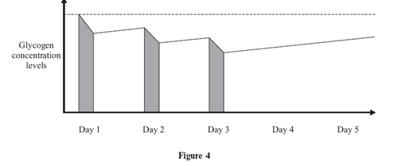
Exam Question
Figure 4 shows the effects of daily 10-mile runs on the concentration levels of glycogen in muscles.
(a) Explain what Figure 4 shows, and briefly explain the role of glycogen in endurance performance.
(4 marks)
(b) How could elite endurance performers try to artificially increase their glycogen stores in an attempt to improve performance? (2 marks)

Slide 23
Mark Scheme
a)
Shows that levels of stored glycogen are depleted during 10 mile run;
Limited glycogen stores;
1 day / 24 hours insufficient time for complete replenishment / equivalent;
Lack of glycogen causes fatigue or deterioration in performance;
Provides energy (store);
For ATP resynthesis;
Through oxidation / aerobic;
(b) Either –
1 Dietary manipulation – (3-4 days) prior to competition ingest no carbohydrates;
2 (Day) before competition – high carbohydrate diet, e.g. pasta / carbo loading;
Or –
3 Exercise plus diet – 4-6 days prior to competition take exhausting run;
4 Maintain low carbohydrate diet until day before competition – then carbo load;
Or -
5 Reduce intensity of training leading up to event;
6 Maintain high carbohydrate diet.

Slide 24
Training Effects
Training can only increase VO2 max by 5-10% (it is largely genetic).
The idea of ‘becoming fitter’ is more concerned with delaying the Onset of Blood Lactate (lactate threshold).

