Slide 1
Improving Fitness and Health
Learning Objectives:
To be able to explain the concepts of health and fitness.
To be able to define and explain a variety of fitness components.
To be able to analyse the effect of lifestyle choice on health and fitness.

Slide 2
Health and Fitness
Health – a state of complete physical, mental and social well-being and not merely the absence of disease or infirmity.
Fitness – to be able to cope with the demands made during an individual’s day-to-day life.

Slide 3
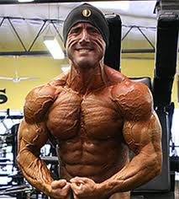
The Relationship between Fitness and Health
‘Being fit’ is one component of health.
Health-related components of fitness are important for health.
Other important factors include nutrition, living conditions, genetic background and age.
Is it possible to be fit but not healthy?

Slide 4
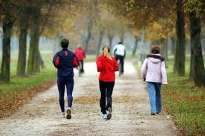
Health-Related Fitness
Physiologically based factors that enable an individual to cope with the demands of their life, and may also have an effect on health.
Stamina (cardio-respiratory endurance)
Strength
Speed
Muscular endurance
Flexibility
Power

Slide 5
Stamina
Aka; endurance, aerobic capacity, cardio-respiratory fitness.
Stamina is the ability to sustain stressful physical exertion for a period of time.
Aerobic capacity is dependant on the efficiency of: the lungs, the blood (in taking up oxygen), the cardiovascular system (in transporting blood), the cells (in taking up and using oxygen), the removal of waste products.
Deficiencies in the cardio-vascular system account for many health problems including heart disease.

Slide 6
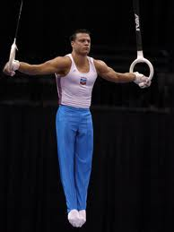
Strength
Strength is the ability to overcome a resistance. This may be explosive, static or dynamic.
Explosive strength – the rapid contraction of muscle fibre units to achieve maximum force generation. E.g. jumping, throwing.
Dynamic strength – the repeated contraction and relaxation of a single muscle or group of muscles repeating a movement over time.
Static strength – the holding of a body part in a static position. E.g. holding a crucifix position in gymnastics.
Core body strength is important for health in avoiding back injuries.

Slide 7
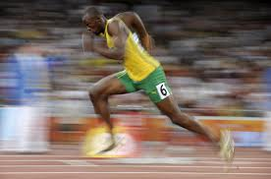
Speed
Speed is the rate at which the body is moved from one place to another.
Speed involves the coordinated contraction of a range of muscles throughout the body.
Speed links to health through everyday activities such as running for a bus.

Slide 8
Muscular Endurance
Muscular Endurance is the ability of a muscle or group of muscles to perform repetitive contractions over a period of time.
This should not be confused with stamina.
A deficiency in muscular endurance may be an indicator of poor aerobic fitness and subsequent health issues.

Slide 9
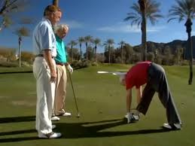
Flexibility
Flexibility is the range of movement around a joint.
An important aspect for effective skill and technique action as well as a contributory factor for speed and power.
Vital for everyday mobility and injury-avoidance.

Slide 10
Power
Power is the rapid application of muscular force. Strength and speed combined.
Vital in a range of sporting skills, E.g. badminton smash, shot putt etc.
Occasionally needed in everyday life, E.g. hammering a nail.

Slide 11
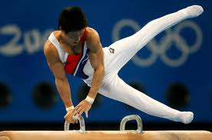
Components of Skill-Related Fitness
Neuromuscular factors that enable an individual to successfully perform skills or techniques.
Coordination: a balanced and effective interaction of movements or body actions.
Reaction time: time taken from the start of a stimulus to the start of a response.
Agility: the ability to change direction at speed.
Balance: maintaining stability or equilibrium.

Slide 12
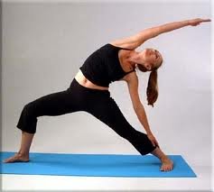
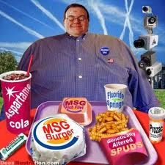
How Lifestyle Choices affect Health and Fitness
Diet – a balanced diet is essential. Over consumption of proteins, fats are carbs can lead to obesity, heart disease, diabetes etc.
Exercise – regular exercise is essential for maintaining health and fitness. Lack of exercise can reduce our aerobic capacity, flexibility and strength as well as increasing body fat percentage.

Slide 13
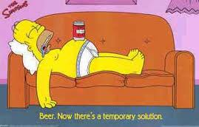
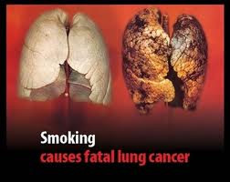
How Lifestyle Choices affect Health and Fitness
Alcohol – excess alcohol consumption can lead to liver damage, cancer, heart disease, high blood pressure, psychiatric disorders, depression etc.
Smoking – can result in: lung cancer, heart disease, stroke, gangrene, bronchitis, shortness of breath, etc.

