Slide 1
Levers
Learning Objectives:
To be able to describe the three classes of lever.
To know which levers have a mechanical advantage/disadvantage.

Slide 2
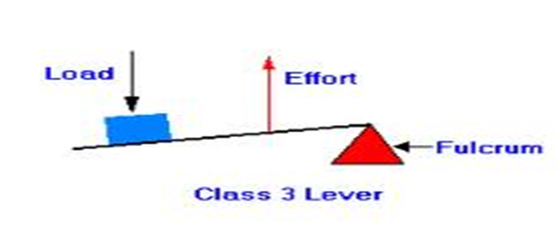
Levers
In order to produce movement your muscles and bones work together as a series of levers.
Levers involve:
Fulcrum (pivot) – the point about which the lever rotates (the joint involved).
Resistance (load) – the load that is being moved.
Effort – the force applied by the person (the muscle that is the agonist).
E.g. for a bicep curl the elbow is the fulcrum, the biceps produce the effort and the dumbbell is the resistance.

Slide 3
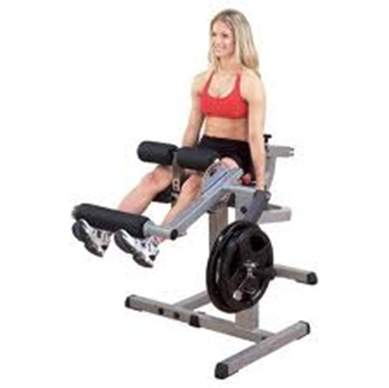
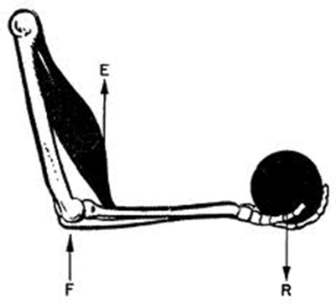
Classification of Levers
First Class – fulcrum in the middle.
Second Class – resistance in the middle.
Third Class – effort in the middle.
Remember FREE (minus an E of course!)

Slide 4
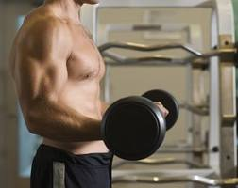
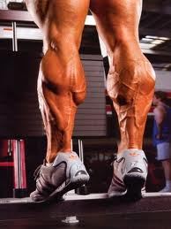
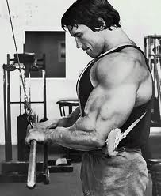
Which is the 1st, 2nd, and 3rd class lever?

Slide 5
First Class Lever
Fulcrum in the middle.
E.g. the elbow. During extension the triceps are the agonist (effort), the elbow is the fulcrum and the weight of the arm is the resistance.
This occurs in throwing or during a press up.

Slide 6
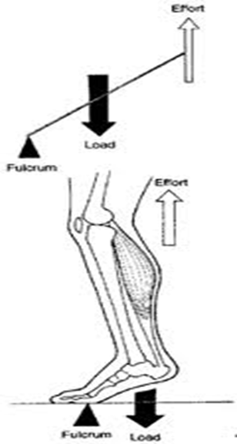
Second Class Lever
Resistance is in the middle.
E.g. the foot. During dorsiflexion the ball of the foot acts as the fulcrum, the gastrocnemius provides the effort and the weight of the body is the resistance.
This occurs when jumping or running.

Slide 7
Third Class Lever
Effort is in the middle.
E.g. Nearly every joint in the body.
For example when performing a bicep curl the elbow is the fulcrum and the dumbbell is the resistance. The effort comes from the biceps which attach to the radius (between the fulcrum and the resistance).

Slide 8
Advantages/Disadvantages
Force arm – distance between fulcrum and effort.
Resistance arm – distance between fulcrum and resistance.
When the force arm is very short and the resistance arm very long (as in third class lever) there is a mechanical disadvantage.
For example, the biceps acting on the elbow joint cannot move large resistances.
However, they also have an advantage that they can produce a large range of motion (nearly a full 180 degrees).
They also have the advantage that only a small amount of bicep movement is required to produce a large amount of movement of the hand.

Slide 9
Advantages/Disadvantages
Second class levers have a mechanical advantage.
The force arm is longer than the resistance arm.
E.g. during plantar flexion (standing on toes).
They can generate much larger forces.
However, the range of movement is small and the movements tend to be slow.

