Slide 1
Exercise physiology Preparation & training methods training methods
Learning Objective:
To be able to name and define a range of training methods and explain how each of these can be of benefit to different performers.
2.2.1 Knowledge and understanding of preparation and training methods in relation to maintaining and improving physical activity and performance.
2.2.11 The appropriateness of methods of training for different activities. This should link to fitness testing and selecting the most appropriate methods for the individual needs. Definitions of each of these will need to be learnt as well as the advantages and disadvantages of each method. Learners will need to be able to justify why different types of training may be used by particular athletes.

Slide 2
There are 14 methods of training you need to be able to define, explain advantages/disadvantages of, and justify appropriateness for specific athletes.
Interval | Circuits |  | Cross
Continuous | Static Stretching |  | Dynamic Stretching
Weights | Resistance |  | Assisted
Plyometrics | SAQ |  | Functional Stability
Proprioceptive Neuromuscular Facilitation |  | Fartlek

Slide 3
Circuits
Performing different exercises in a sequence at different exercise stations so that different body parts are worked successively.
Variables include:
Exercises
Time per station.
Rest time between stations & circuits.
Number of circuits completed.
Exam Question:
Outline the advantages of circuit training. (4 marks)

Slide 4
Mark Scheme
Adaptable to many sports
Large numbers of athletes can train together
Can be carried out cheaply
Can be done anywhere
Can be adjusted to suit specific body parts
Can be adapted to specific requirements of a sport

Slide 5
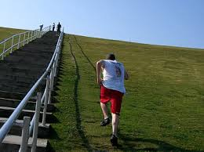
Continuous:
Long duration where intensity remains constant throughout with no rest or break. Improves cardiovascular fitness.
Duration of sessions should be at least 20 minutes.
Frequency of sessions should be at least 3 times per week.
Pace can be adjusted to vary the intensity (recommended 60-75% MHR)
Fartlek:
A long duration activity where the intensity varies. Improves cardiovascular fitness.
Intensity can be increased/decreased by adjusting the frequency and duration of low/high intensity periods.

Slide 6
Interval training:
Training with a work-to-rest ratio (W:R) that is repeated.
Variables include:
Duration of the exercise period.
Intensity of the exercise period.
Number of repetitions within a set.
Number of sets within a session.
Duration of the rest intervals for recovery.
How these variables are tailored determines the adaptive response produced:
ATP-PC intervals have very high intensity work periods of 3-10 seconds with no more than 2 minutes rest periods → Increases ATP-PC stores.
Lactic acid intervals have medium/high intensity work periods of 15-90s with variable recovery depending on length of work period → Increases blood buffering capacity.
Aerobic intervals have low intensity work periods lasting beyond 20 mins with short recovery → Increases aerobic capacity.

Slide 7
Mobility Training
STRETCHING
STATIC | Static
 | Active
 | Passive
 | PNF
DYNAMIC | Dynamic
 | Ballistic

Slide 8
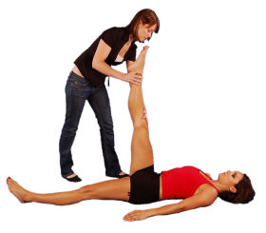
Static stretching:
A stretch that is held in a challenging but comfortable position for a period of time, usually somewhere between 10 to 30 seconds.
Active stretching:
Slow stretching without assistance. Only the strength of the opposing (antagonist) muscles are used to hold the position.
Passive Stretching:
Similar to static stretching, however a partner or apparatus is used to help stretch the muscles.

Slide 9
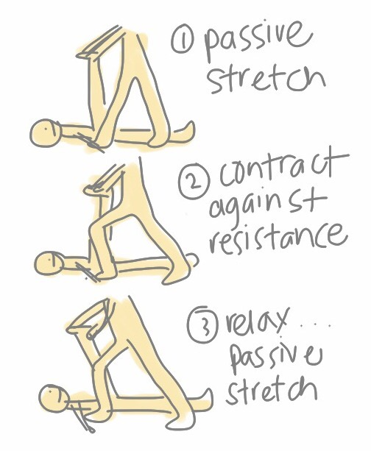
Proprioceptive neuromuscular facilitation (PNF):
1. A muscle group is passively stretched.
2. Then contracts isometrically against a resistance while in a stretched position.
3. Then passively stretched again.
Often uses a partner to give resistance.

Slide 10
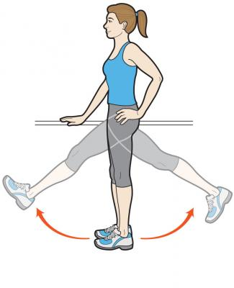
Dynamic stretching:
Stretching involving movements that are soft, gentle and controlled.
Ballistic:
The use of momentum of a body or limb to force it beyond its normal range of motion. The movements of the stretch are more aggressive and rapid than dynamic stretching.

Slide 11
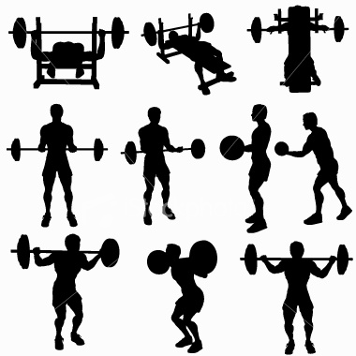
Weight Training
Training with weights against a (variable) resistance either on machines or with free weights. Improves strength, power, muscular endurance.

Slide 12
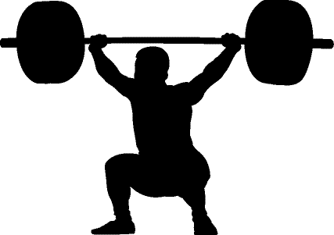
Using Reps and Sets
Will use in different ways depending on the aspect of strength you wish to improve…
Muscular strength
Near max weight
3 sets
6 reps
Muscular Endurance
40-60% max weight
At least 3 sets
20 – 30 reps
Power
60-80 max weight
At least 3 sets
10 - 15 reps

Slide 13
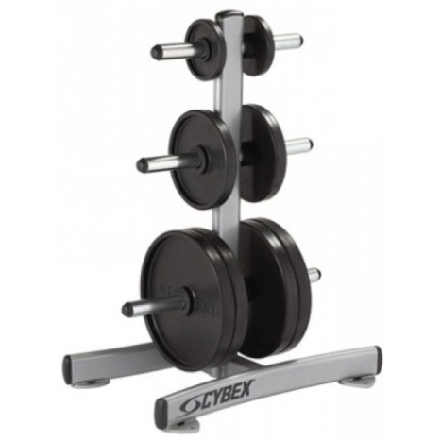
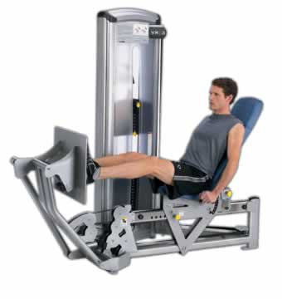
Types of weight training
Two main types depending on the weights you use…
Free Standing weights
Dumbbells, Barbells and bars
Adaptable weight
Can be purchased at home
Limited in safety as should have a training partner
Specialist weight-training equipment
Machines found in gyms, leisure centres etc.
Fixed weights within machine, changeable by moving pin
Safer to use as machines reduce chance of injury.

Slide 14
Identify four muscular-skeletal adaptations of the body to weight training, using heavy weights and few repetitions. (4 marks)
Any four of:
muscular hypertrophy (increase fibre size) (1)
increase in tolerance to lactic acid (1)
increased bone density (1)
increased fibre recruitment rate (1)
increased number of fibres recruited (1)
increase force production (1)
increase anaerobic metabolism (1)
increased PC stores (1)
more anaerobic enzymes (1).

Slide 15
Compare the use of free weights versus machines for weight training. (12)
Reward acceptable answers. Responses may include, but are not limited to the following.
Free weights
• Free weights use multiple muscle groups/joints and can improve coordination as well as muscle function (AO1).
• Free weights are adaptable to specific movements in your sport (AO2).
• Correct technique and risk of injury on free weights (AO2).
• Need for a spotter/safety if building mass and using heavy weights (AO2).
• Can use smaller increments (AO2).
• Incorporates stabilising muscle groups (AO1).
Machines
• Machine weights isolate muscle groups and therefore target only muscle function (AO3).
• Machine may not fit individual correctly (AO1).
• Machines take weight so you do not build up stabilisers (AO3).
• Resistance increments may be too large on machines (AO2).
Other points of comparison
• Cost of free weights v machines (AO3).
• Space required and ease of use of free weights v machines (AO3).
• Isolation v compound exercise (AO3).
Other appropriate examples of points of comparison are acceptable.

Slide 16
Resistance training (including pulleys and parachutes):
Exercising your muscles using an opposing force. Practical video
Improves strength and speed.
Assisted training (including bungees and downhill):
Bungee running uses the recoil action of the bungee cord to pull you at a faster rate than you could achieve on the flat or in a voluntary sprint. This technique forces your muscles to work at a higher intensity than they normally would, which trains the nerve cells that control movements and coordinate leg-muscle activity during very quick contractions to function at accelerated firing rates. Practical video ; Further info
Improves speed.

Slide 17
Explain why an athlete would use assisted training. (4 marks)
Bungee running uses the recoil action of the bungee cord to pull you at a faster rate than you could achieve on the flat.
Downhill running enables you to achieve a faster rate than you could achieve on the flat.
Assisted training forces your muscles to work at a higher intensity than they normally would.
Assisted training forces the nerve cells that control movements and coordinate leg-muscle activity to work at a higher rate than they could achieve on the flat.
During very quick contractions muscles are trained to function at accelerated firing rates.

Slide 18
Plyometrics:
Jumping, bounding and hopping exercises designed to improve power. A movement involving an eccentric contraction immediately before a concentric contraction.
Speed agility quickness (SAQ):
Targeting neuromuscular adaptations to aid speed of muscle firing. Football SAQ
Arsenal FC SAQ
Functional stability training:
Ensure there is a stable base for the limbs to function from otherwise there’s a loss of force and possible injury risk. A stable core requires a well-conditioned deeper lying trunk muscles and a balance between opposing muscle groups (www.functionalstability.com). Practical video
Improves core strength.

Slide 19
Cross:
Training in two or more sports in order to improve fitness and performance in a main sport.
This is a tactic used when planning a training programme, adding variety to the activities being undertaken to increase motivation and provide “fun”.
You often see elite sports teams playing sports other than their own in training sessions, as a warm up, part of their recovery or just for fun!
Team sport players can play squash to develop fitness for their own sport.
Squash is very high intensity so develops anaerobic fitness.
Squash games mimic interval training as each point is the equivalent of a work interval and the small break between each point is a rest interval.

Slide 20
Assess whether cross training is a useful method of training for a games player. (8)
Answers in bullet points are not sustained responses and therefore will only score a maximum of band one
Reward acceptable answers. Responses may include, but are not limited to the following:
Cross training is training in two or more sports or modes of exercise to improve fitness or performance in a main sport. (AO2)
Depending on the games being played - the central CV system will be involved in different exercise and therefore any gains will benefit across activities. (AO2)
Can provide a more all-round body work out. (AO2)
May not be specific enough for elite level performers. (AO3)
Depending on the sports there may be transfer of skill / tactical awareness. (AO3)
Variety of methods with cross training can reduce / enhance motivation. (AO2)
Provides opportunities for active recovery (AO2)
Cross training can be used during rehabilitation from injury. (AO2)
Cross training can be used to reduce the effect of impact forces from running based activities (AO2)

Slide 21
Analyse whether interval training is a valid method of training for an elite marathon runner. (15)
Reward acceptable answers. Responses may include, but are not limited to the following.
• Discussion centred around the suitability or not of interval training for an elite marathon runner (AO3).
Argument against using interval training/reasons why it is not valid
• Marathon running is traditionally an endurance-based event (AO2).
• Interval training is ‘traditionally’ associated with high-intensity and short duration activities, even maximum intensity (AO2).
• Marathon runners would rarely work at maximum intensity (AO2).
• Continuous and Fartlek would be more traditional methods of training for a marathon (AO2).

Slide 22
Argument in favour of using interval training/reasons why it is valid
• Interval training is very adaptable (AO3).
• The work and the rest periods can be manipulated in order to achieve the desired outcome (AO3).
• Interval training is used to enable an athlete to work at a higher than normal intensity, but this can be adapted for a marathon runner (AO3).
• A marathon is a race and a measure of speed, and an elite athlete will want to run faster and win the race (AO3).
• To improve speed the athlete needs to overload and interval training facilitates this (AO3).
• Long intervals of up to 20 minutes performed in sets of three are a good way to improve functional threshold (AO3).

